Slide 1
Basic Workplace English Conversations Staff Training 3 職工進修 3 英文應對禮儀
Dr. Pei Lun Kao
Language Center
Chang Gung University
8-10 July 2024

Slide 2
Session 3: Basic telephone etiquette
A. Handling complaints 處理抱怨
B. Offer to follow up 提供後續的處理
C. Giving negative news in a professional way 以專業方式告知負面的消息
D. Demonstrate professional attitudes
展現專業態度

Slide 3
A-1. Handling complaints 處理抱怨
You may hear these… 可能會聽到的抱怨
A number of problems have appeared. But you have promised to solve them last time. We expected a document from your office urgently. But it did not arrive. The quality of the dormitory is not satisfying. Many students moved out because of that. The principal was very angry at us because of the news from your office. My scholarship application process kept failing even though I have tried many times.

Slide 4
A-2. Handling complaints 處理抱怨
I. Acknowledging 表達知悉（同理情緒） | II. Apologizing 道歉
1. "I realize how frustrating this must be for you." 2. "I can see why you're upset about this." 3. "It sounds like this has been a really challenging situation for you." 4. "I can see your point on that." 5. "Thank you for sharing that with me." | I’m very sorry to hear about this problem. I’m terribly sorry about this delay I’m afraid there has been a mistake. I regret to say that there has been a mix-up. I’m sorry for the inconvenience. I’d like to apologize on behalf of our company. And I must thank you for being understanding.

Slide 5
B-1. Offer to follow up 提供後續的處理
III. Showing willing to help 表達盡力協助
I will do my best to resolve this for you as soon as possible. If you could give me your name and order number, I’ll start looking into this immediately. I totally understand. I would feel the same way. Please give me a moment to look into this and find the right solution for you.
IV. Transfer phone calls 轉接電話給負責人
I understand. I’m going to transfer you to our Academic Affairs Office/ Department of Medicine. They’ll be able to help you with this request/matter/ issue. 2. I see. Let me transfer you to Patrick Pong who is in charge of the scholarship. He is the right person to talk to. I’m sure he’ll be able to help you. Would you mind being on hold while I get in touch with him for you?

Slide 6
B-2 Putting on hold https://www.youtube.com/watch?v=LRJXMKZ4wOw 請對方等待/ 需要更多時間處理
請對方等待並說明原因
I see. I am going to need a moment to check that for you/ to talk with our director. Would you mind being on hold while I do that? Thank you for holding and being so patient. I am sorry it took a little longer than expected. I have that information for you now.
需要更多時間後續處理
Sorry, Mr. Lee. Can I check this with my manager/director and reply to you in the next hour? Mr. Lee, I‘m afraid I’ll need more time to look into this for you. Would you mind if I call you back in the afternoon when I have found the solution for you?

Slide 7
C. Giving negative news in a professional way 以專業方式告知負面的消息
告知對方不想要的結果或回應
"Regrettably, it is not possible for us to fulfill your request in this instance because ______(It's against FDA regulations/your warranty doesn't cover this, etc.)” 2. "I know this is not what you want to hear, but we cannot provide the solution you want.” 3. "I understand that this is not the outcome you were hoping for, and I'm sorry for any inconvenience it may cause.” 4. "While I wish we could do more, we cannot accommodate your request.” 5. "I'm sorry to inform you that we cannot provide the assistance you're seeking."

Slide 8
End a circular conversation 結束重複的對話
Facing an upset client, 面對沮喪的客戶要如何堅持立場
1. We realize this is frustrating for you. But we cannot….
2. We won’t be able to….
3. I respect your opinion. Our policy is….We have a responsibility. As long as…, we cannot
4. To prevent this from happening in the future, there might be some tips on how to…
5. I agree ….., regrettably that’s not possible because…..

Slide 9
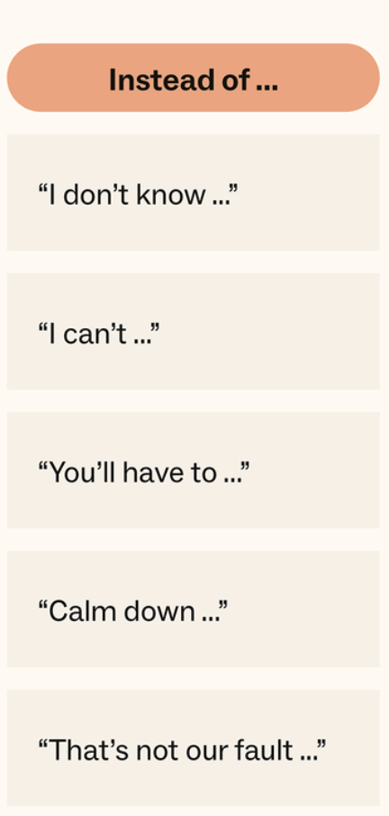
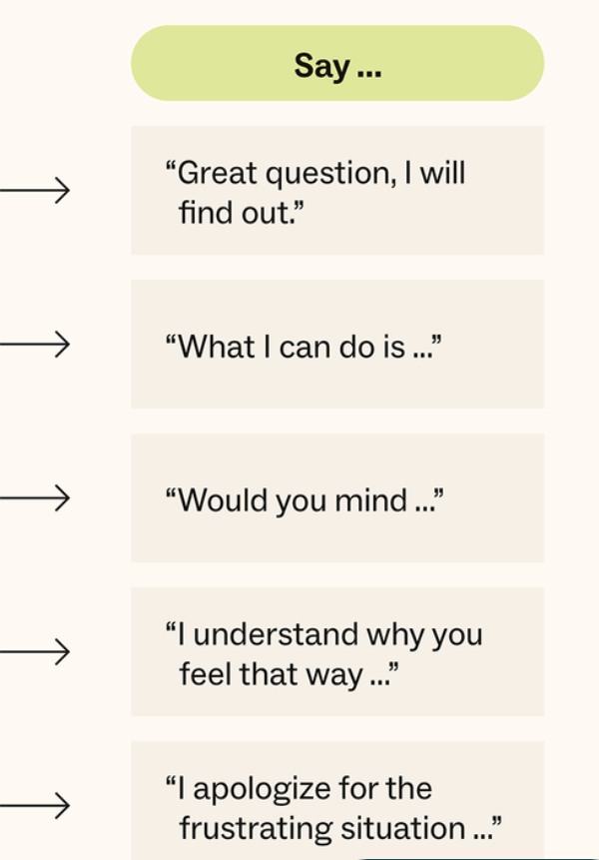
D. Positive alternatives to negative language for customer service 正面的說法

Slide 10
Be professional 展現專業的態度- 職場該說或不該說 https://www.youtube.com/watch?v=0_6B6tlpIdM
 | Don’t | Do
1. | I don’t know. ( means - I don’t care) | I am not sure. But I can find out. 不確定但是我會找出答案。 I will find out for you. Let me come back to you on that.
2. | I‘ll try. (- not committed) | Sure I can get it done by 4pm. I don’t think I can finish it by 2pm. But I can do it by 4pm.

Slide 11
References
1. 36 English phrases for professional customer service https://www.youtube.com/watch?v=LRJXMKZ4wOw
2. How to deal with angry customers: 17 tips, templates, and examples
https://www.zendesk.tw/blog/the-best-templates-for-dealing-with-angry-customers/
3. 57 Phrases to De-escalate Any Angry Customer
https://www.myragolden.com/blog/57-phrases-to-de-escalate-any-angry-customer

