Slide 1
Chasing Your
American Dream
Yu-Wen Chang, Ph.D., DABR
Chief Medical Physicist
Varian AOS
Email / iMessage : Yu-wen.Chang@Varine.com

Slide 2
Post College
May 2002 – March 2003: MRI Center, CGMH
April 2003 – July 2004: Dr. Hsiao’s Lab, CGU
TOEFL: Reading, Listening, Speaking, Writing
GRE: Verbal Reasoning, Quantitative Reasoning, Analytical Writing

Slide 3
Graduate School Era
September 2004 – February 2006: Master Research Assistantship
  University of Missouri – Columbia
March 2006 – December 2007: Doctoral Research Assistantship
  University of Missouri – Columbia
  University of Missouri Research Reactor
December 2005 – January 2006: Medical Physicist Internship
  Saint Louis University Hospital
February 2008 – October 2008: Medical Physicist Internship
  Medical College of Wisconsin

Slide 4
Graduate School Era
M.S. in Medical Physics, University of Missouri – Columbia
  Project Paper: Statistical Analysis of a Radioactive Marker System to Reduce Positioning Errors for External Beam Radiation Treatment
  Project supervisor: William H. Miller, Ph.D.
  Graduated in May 2006
Ph.D. in Medical Physics, University of Missouri – Columbia
  Dissertation: Development and Evaluation of a Novel Ge-68/Ga-68 Generator
  Dissertation supervisor: Cathy S. Cutler, Ph.D.
  Graduated in December 2009

Slide 5
Medical Physicist Era
May 2010 – February 2012: Post-doctoral Fellowship
  Medical College of Wisconsin, Milwaukee, Wisconsin
February 2012 – September 2012: Junior Medical Physicist
  Cancer Treatment Institute, El Paso, Texas
September 2012 – June 2014: Medical Physicist
  UMC Health System SWCC, Lubbock, Texas
June 2014 – September 2015: Medical Physicist / Radiation Safety Officer
  Meadville Medical Center, Meadville, Pennsylvania
September 2015 – June 2020: Medical Physicist
  Bellin Health at Cancer Team, Green Bay, Wisconsin
ABR Part I
ABR Part II
ABR Part III

Slide 6
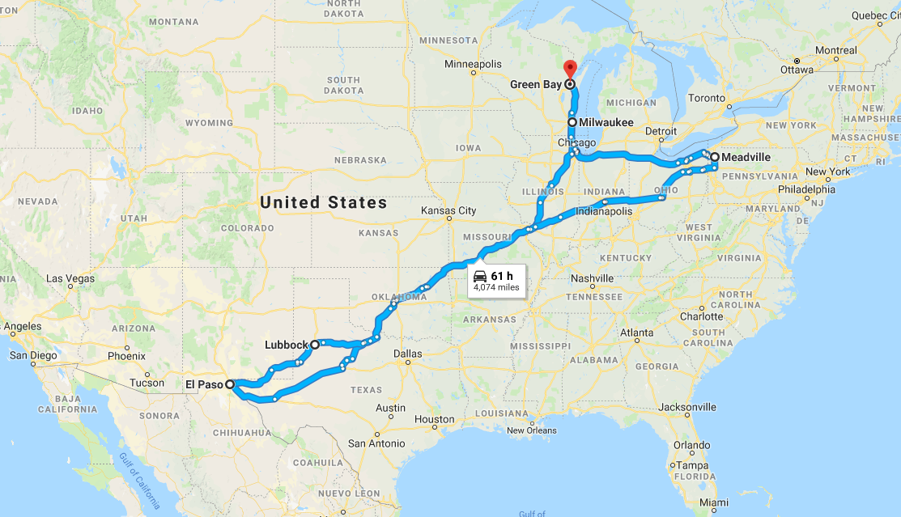

Slide 7
Medical Physicist Era
July 2020 – June 2022: Medical Physicist
  ThedaCare Regional Cancer Center, Appleton, Wisconsin
June 2022 – December 2023: Senior Medical Physicist
  Varian AOS (Advanced Oncology Solutions)
December 2023 – Present: Chief Medical Physicist
  Varian AOS (Advanced Oncology Solutions)

Slide 8






Slide 9
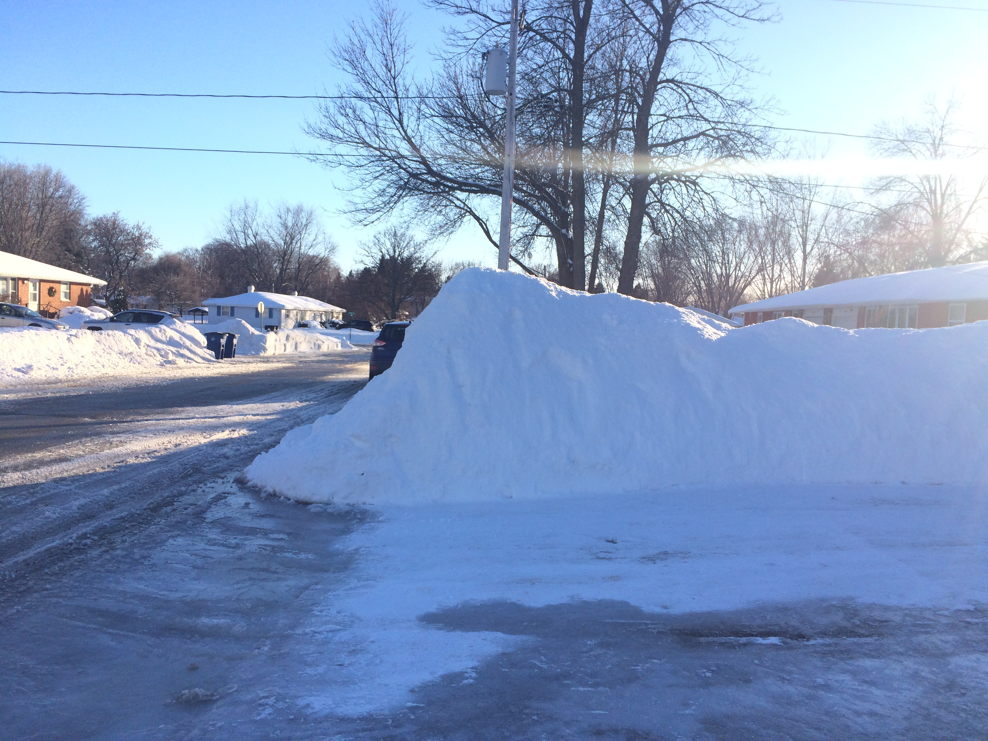
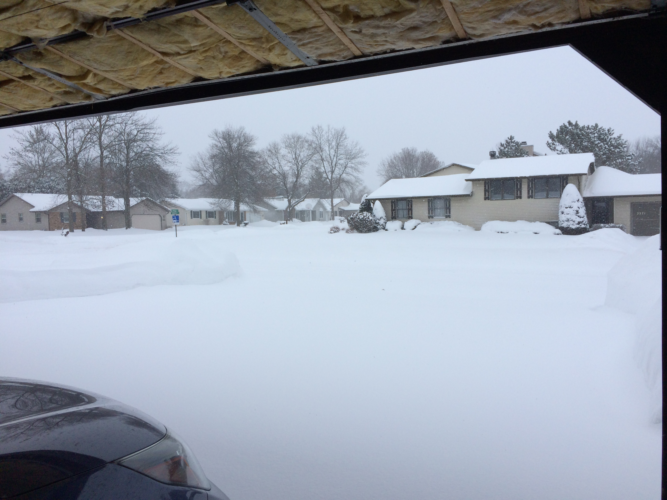
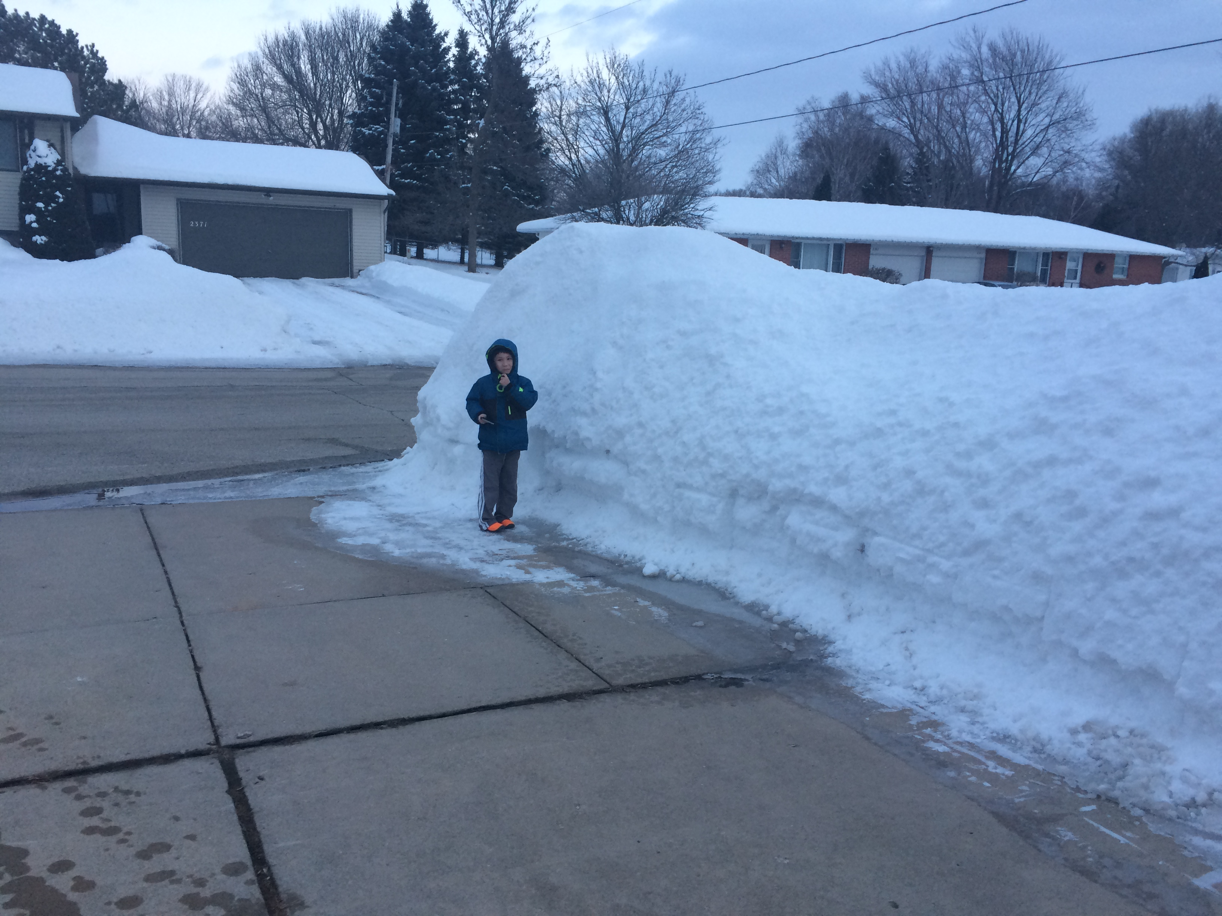
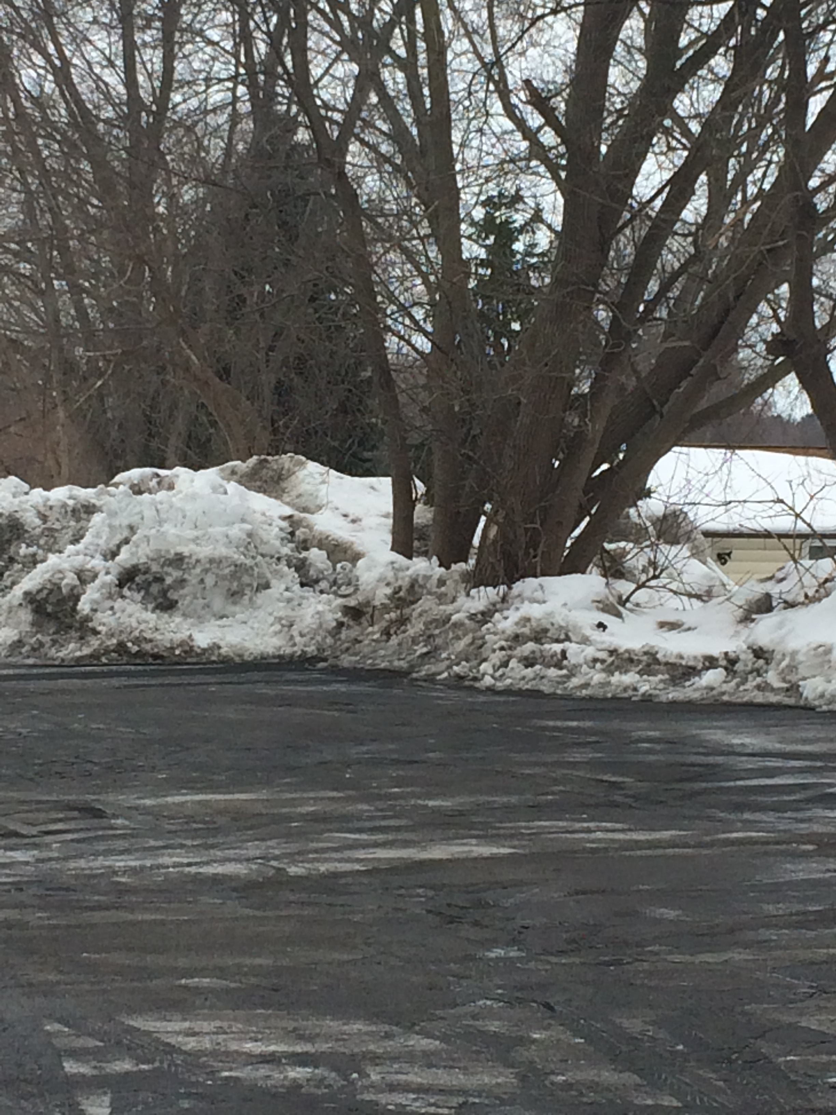
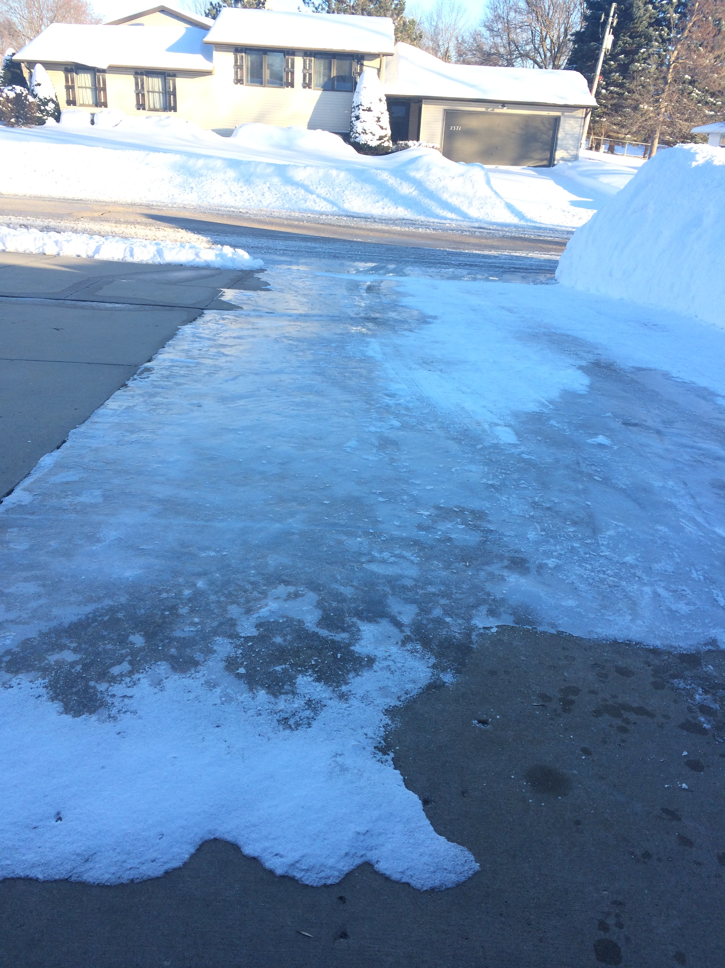

Slide 10

Still awake?

Slide 11
Challenges
Spend time to prepare a good job interview
Office politics: interpersonal skills
Be an effective communicator
Prioritize tasks (urgency and/or importance)

Slide 12
Tips & Tricks
Be prepared to grab the opportunity
Ask right questions
Focus on the path you choose and enjoy the journey: as long as you move forward everyday, you will get to your destination one day.
Try your best to know yourself: maximize what you are good at.

Slide 13
In life you will meet two kinds of people. Ones who build you up, and ones who tear you down. But in the end, you will thank them both.

Slide 14
Thank you for your attention!

