Slide 1
IFMSA-Zaragoza Project
El Pilar
B9602015
Chia-Chen Li

Slide 2
Cell Culture

Slide 3
What is CELL CULTURE?! (1)
Maintaining cell line survival under controlled conditions, in despite of their original environment
  Proliferative capacity
  Differentiation ability
  Corresponding cell age

Slide 4
What is CELL CULTURE?! (2)
Controlled conditions
  ex vivo
  in vitro
Tissue source
  Multi-cellular eukaryotes
  Mainly animals
  Also plants, fungi & microbes

Slide 5
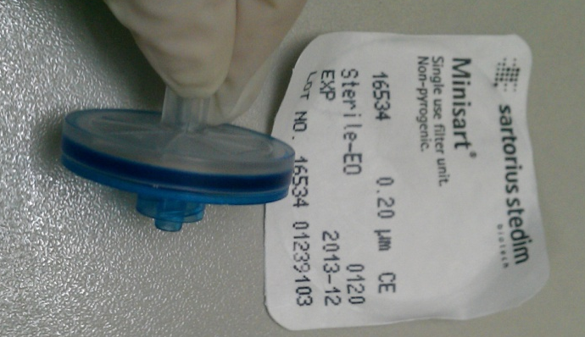
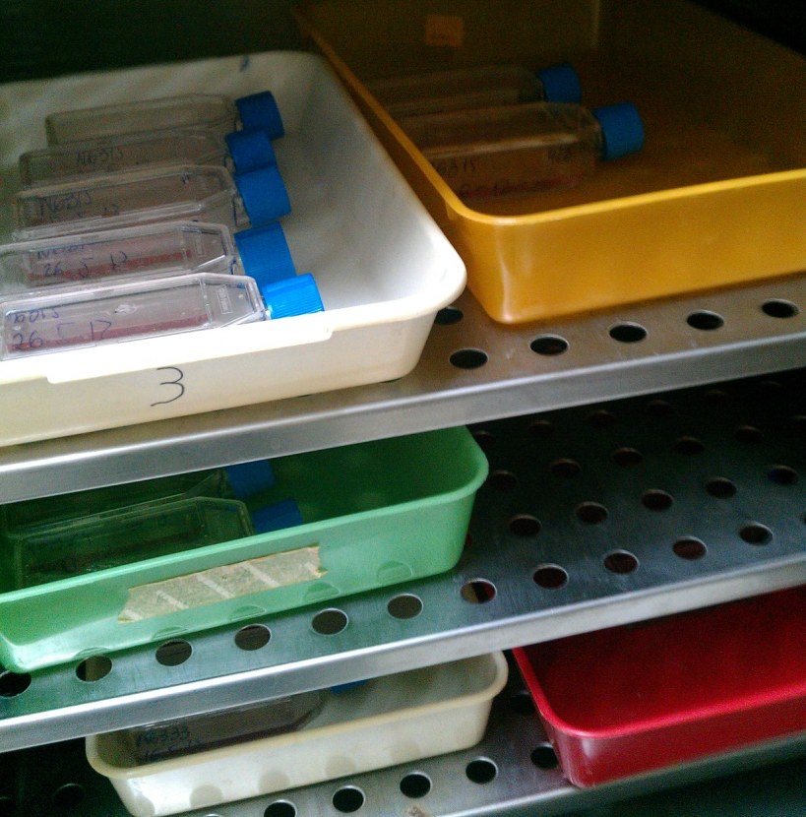
General Requirements (1)
Sterilization
  Methanol
  Filtering by 0.20 μm
Culture surfaces
  Petri dish, flake or plate
Incubation
  Temperature at 37℃

Slide 6
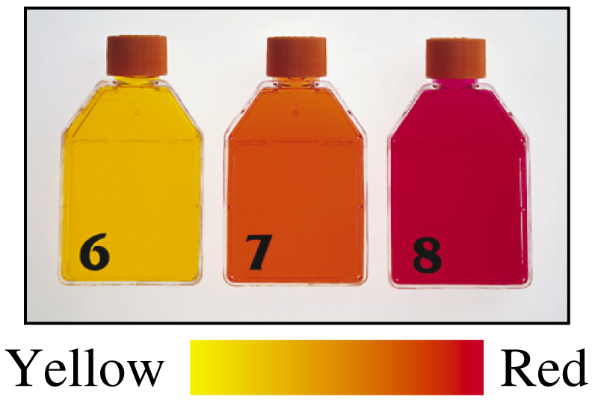
General Requirements (2)
Nutrient media
  Antibiotic
  Buffering
    efficient at pH 7.2-7.6
  CO₂/pH detectable
    Red (pH 8, fresh)
    Yellow (pH 6, wastes)
Trypsin, the growth inhibitor

Slide 7
Daily Care
Changing media (yellow)
Microscopy observation for cell growth monitoring, monolayer
Trypsin
  Reduction for multilayer culture
  Dividing for new flakes
Photographing

Slide 8
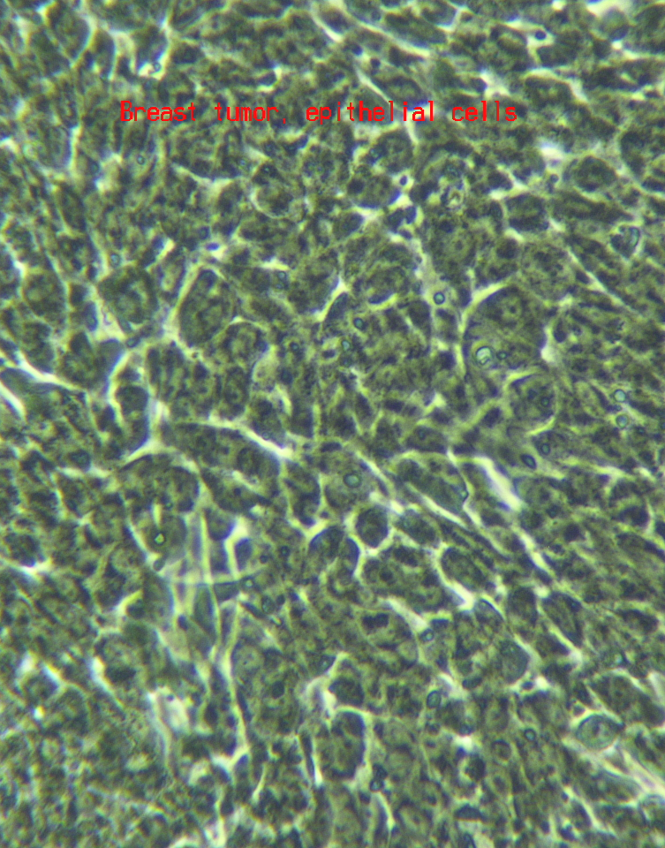
Results (1)
Breast tumor
  derived from nude mice
Hyperchromatic
Hyper-proliferative

Slide 9
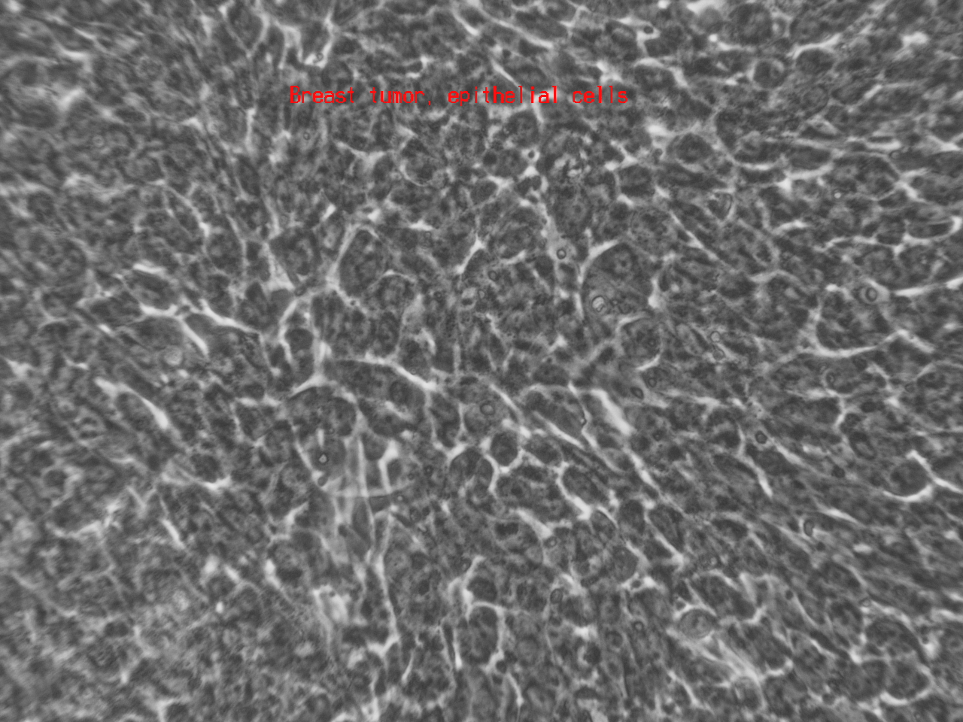
Prominent nuclei

Slide 10
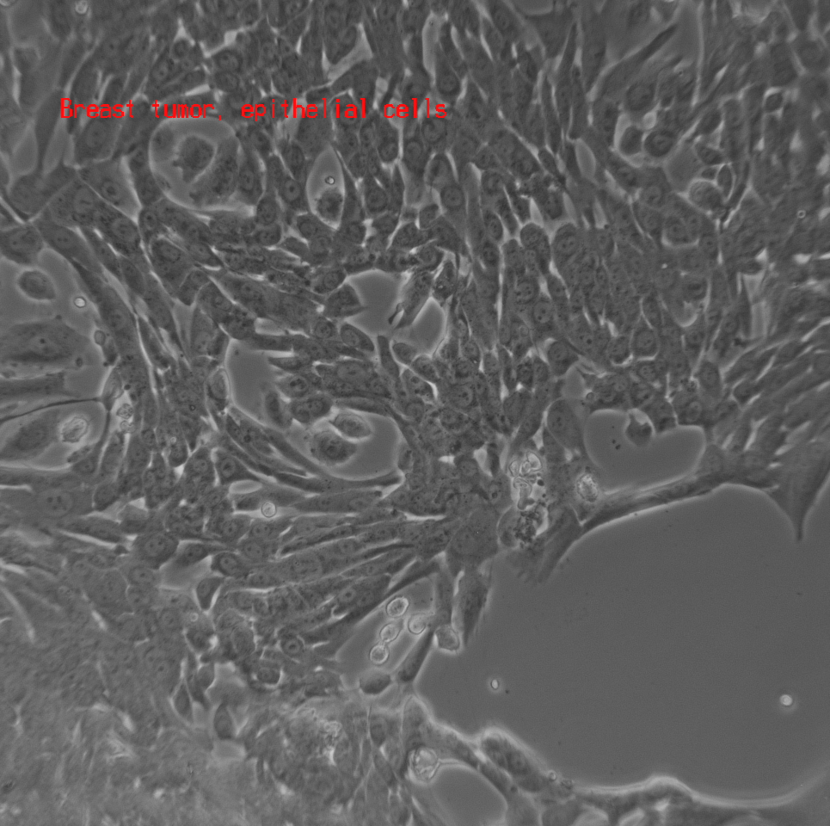
Results (2)
Breast tumor
  from nude mice
Duct
Ductules
ductules
duct

Slide 11
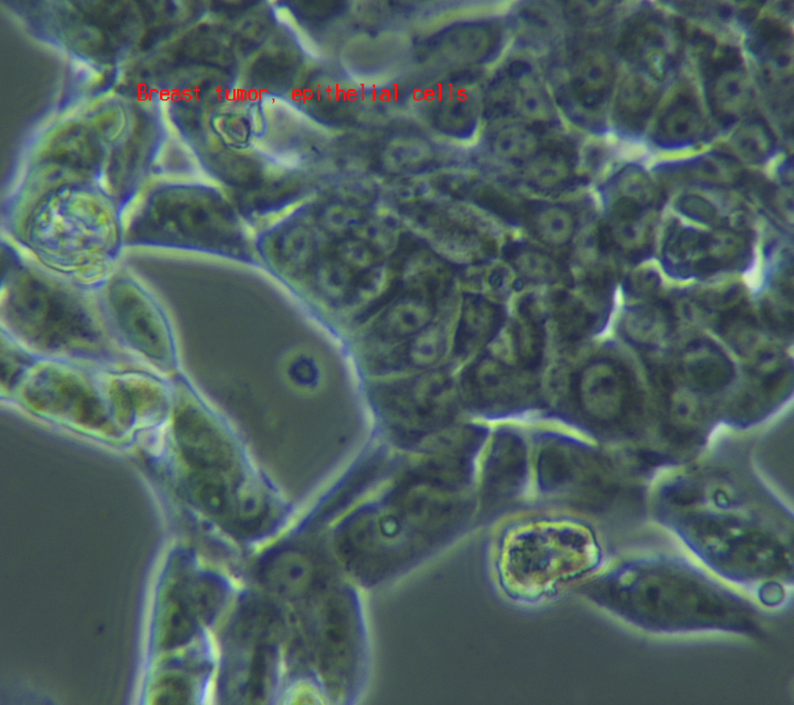
Results (3)
Breast tumor
  derived from nude mice
Epithelial cell alignment

Slide 12
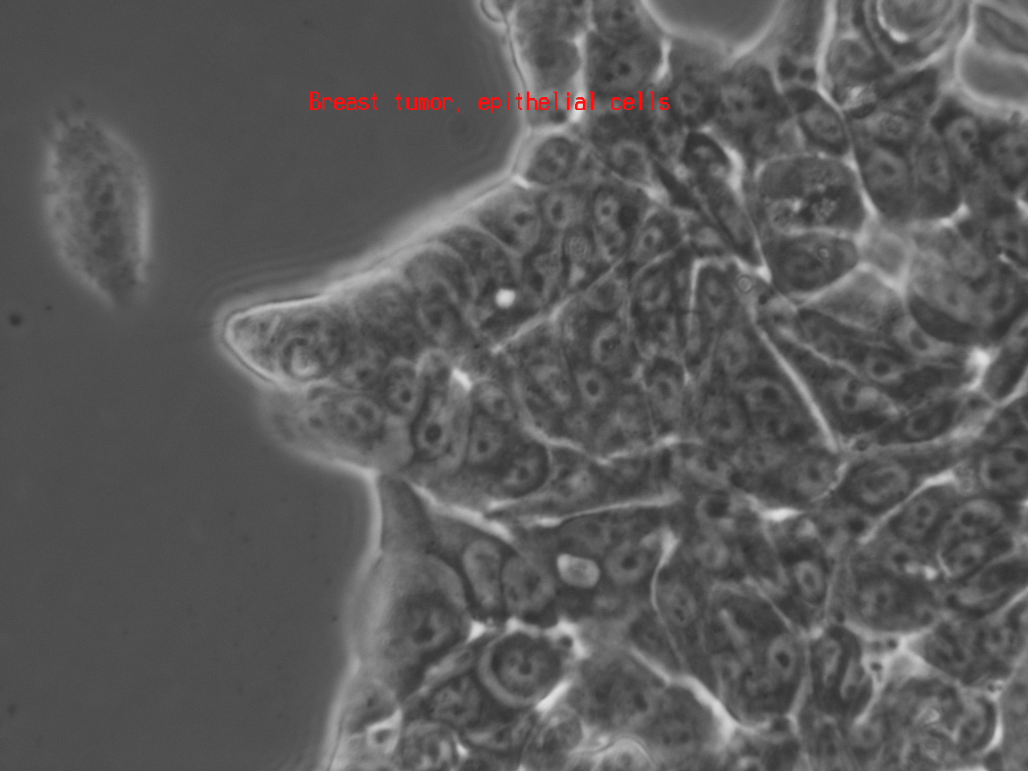
cell alignment

Slide 13
Animal Experiment

Slide 14
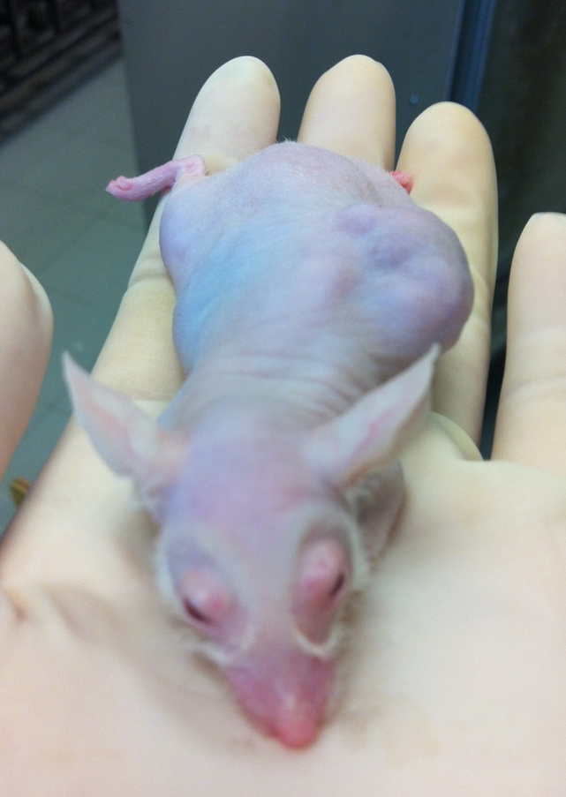
Athymic Nude Mice
Spontaneous genetic mutated mice
  FOXN1 deletion
Immunodeficient
  Lack of mature T cell
  Lack of adaptive immune response
Xenograft transplant
  Human prostate tumor

Slide 15
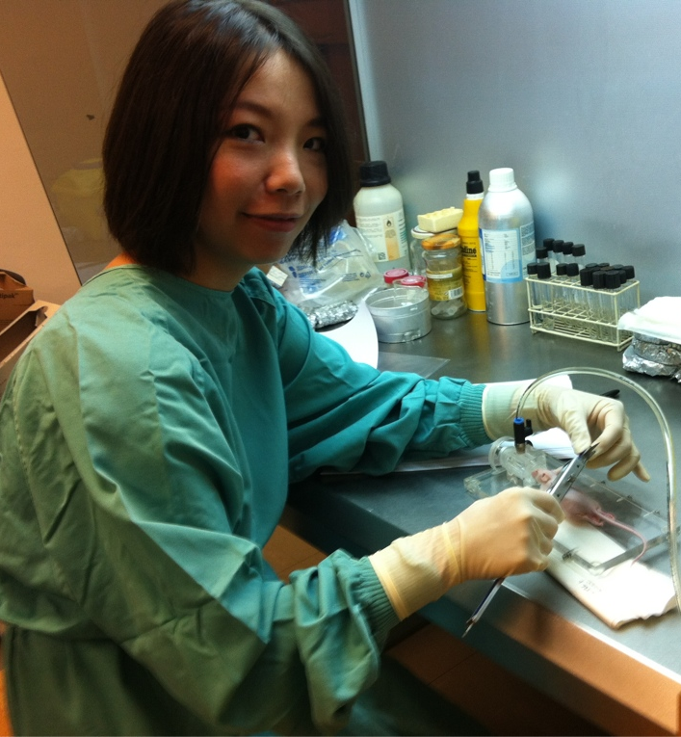
Woking Conditions
Requirements
  Working robe
  Gloves
  Shoe pads
Not allowed
  Bare-handed touching
  Sniffing & etc.

Slide 16
Daily Care for Nude Mice
Provides
  Meal, sterilized
  Water, sterilized
  Bed surface
Used cages must be washed and sterilized for another-time use.

Slide 17
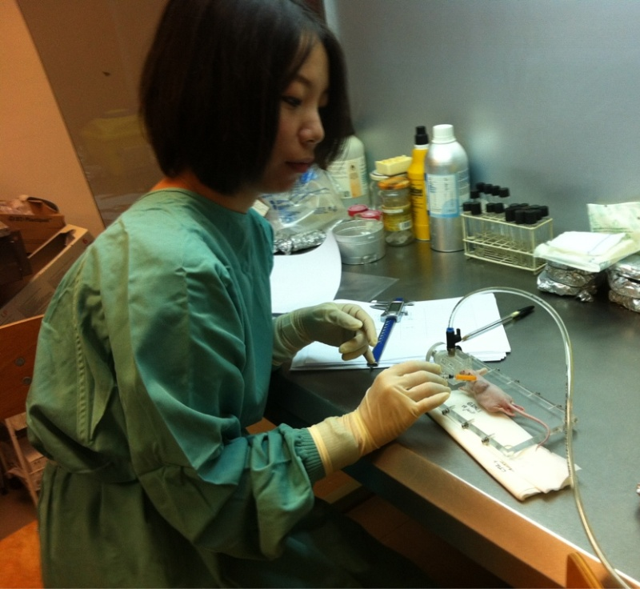
Experiment Design
Intra-tumor injection, 5 times / 3 weeks
  Control
    normal saline buffer
  Variables
    Anti-proliferative ligands
    Granulysin
Tumor size measuring
  Every injection
  The middle of each injection intervals
Under anaesthesia

Slide 18
Efficiency Determination
By square a*b, the 2D area of tumor
Effective potency:
The effectiveness can be confirmed if there’s significant change of the potency, in which the tumor size reduces.
Experiment is still in progress.
a
a₁*b₁ - a₀*b₀
a₀*b₀
b

Slide 19
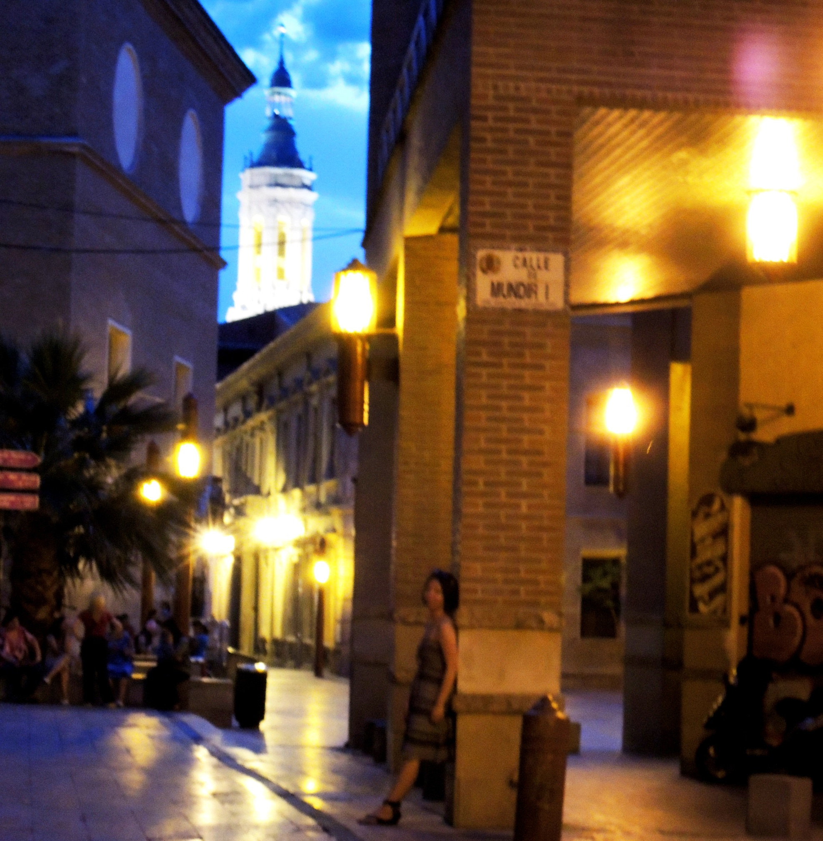
Thanks!
La Seo

