Slide 1
教學助教培訓研習會
科技輔助教學
生物醫學系 & 教學資源中心
蘇文慧 老師

Slide 2
教學助理 (aka 助教) 的工作是啥？
What does a Teaching Assistant do?
課前 Before Class
  設定每週Teams遠距教學
  Set up weekly Teams Distance Learning
  協助部分教材的製作（可能包含 投影片整理 拍攝數位教材）
  Assist in the production of some of the teaching materials
  跟老師確認上課時間, 取得上課教材(ppt), 上傳教材到特定位置（建議是 E-Learning ）
  Confirm class time with teacher, obtain class materials (PowerPoint), upload materials to a specific location (E-Learning is recommended).
  開教室門, 借麥克風，並確定所有教具可用。
  Open the classroom door, borrow a microphone, and make sure all teaching aids are available.

Slide 3
教學助理 (aka 助教) 的工作是啥？
What does a Teaching Assistant do?
課程中During the course
  課程Teams設定及錄影 (學校建議前二週需上傳課程錄影至E-Learning)
  Setting up the course Teams and video recording (the school recommends uploading the course video to E-Learning in the first two weeks).
  跟課並點名
  Help with the roll call.
  實作課程協助學生的疑難雜症，甚至教學生使用工具。
  In hands-on classes, helping students with troubleshooting and even teaching students how to use tools.
  協助考試的進行（包含印考卷、排座位、監考…）
  Assisting with exams (printing, seating, proctoring the exam...)

Slide 4
教學助理 (aka 助教) 的工作是啥？
What does a Teaching Assistant do?
課後After class
  作業相關 （設定E-Learning作業繳交, Turnitin作業抄襲比對, 作業補交）
  Assignment related (Setting up E-Learning assignment hand in system, Turnitin assignment plagiarism comparison)
  學生的問題解答（課程內容或行政相關）
  Answering students' questions
  行政事務（登記成績）
  Administrative affairs (grade registration)

Slide 5
What does a Teaching Assistant do?
Before Class
  Set up weekly Teams Distance Learning
  Assist in the production of some of the teaching materials
  Confirm class time with teacher, obtain class materials (PowerPoint), upload materials to a specific location (E-Learning is recommended).
  Open the door, borrow a microphone, and make sure all teaching aids are available.
During the course
  Setting up the course Teams and video recording (the school recommends uploading the course video to E-Learning in the first two weeks).
  Help with the roll call.
  In hands-on classes, helping students with troubleshooting and even teaching students how to use tools.
  Assisting with exams (printing, seating, proctoring the exam...)
After class
  Assignment related (Setting up E-Learning assignment hand in system, Turnitin assignment plagiarism comparison)
  Answering students' questions
  Administrative affairs (grade registration)

Slide 6
作業抄襲與考試作弊
Plagiarism and Cheating on Exams
務必嚴格執行, 禁止作業抄襲與考試作弊
Strictly enforce plagiarism checking and prohibit cheating on exams.
事先與老師溝通，以免標準不一
Please communicate with the teacher beforehand to avoid inconsistent
standards.
請於第一堂課就訂出抄襲規則與罰則
Set out the rules and penalties for plagiarism in the first week.
  例如 :
    Turnitin比對與網路文字或先前作業相同度超過30%或疑似AI生成即0分
    英文寫作作業禁止以Grammerly, Quillbot等軟體進行文法修飾
作業遲交補交規則最好也先說清楚
The rules for late submission of assignments should be clearly stated.
  遲交扣分, 最後補交期限等
作弊
  一定要抓 一定要抓 一定要抓

Slide 7
Plagiarism and Cheating on Exams
Strictly enforce plagiarism checking and test proctoring.
  Please communicate with the teacher beforehand to avoid inconsistent standards.
  Set out the rules and penalties for plagiarism in the first week.
The rules for late submission of assignments should be clearly stated.

Slide 8
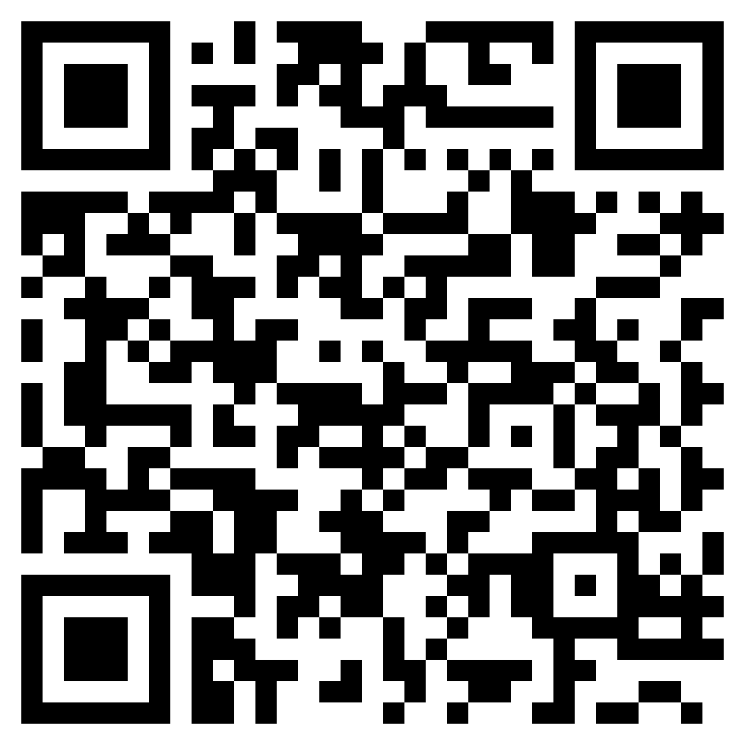
我沒抄我Chatgpt
請參考教學資源中心 ChatGPT與教學
Please refer to the Teaching Resource Center: ChatGPT and
Teaching
TA 自己應該使用 chatGPT 了解 chatGPT 產生的文字規律Teaching assistants should use ChatGPT themselves to understand the patterns of text generated by ChatGPT.
學校鼓勵學生使用 chatGPT
The school encourages students to use ChatGPT.
沒有經過理解與消化的而全盤複製的答案，都可以當成抄襲。
Answers that are copied verbatim without understanding
or assimilation can be considered plagiarism.
但是，要能知道這是 chatGPT 產生的答案，有其困難。
However, it is difficult to determine that an answer was
generated by ChatGPT.

Slide 9
學校常用的與上課相關的系統
Classroom-related systems
  Microsoft Teams
  Turnitin
  E-Learning

Slide 10
Microsoft Teams
遠距教學 課程內容錄影
Distance Learning Course Content Recording System

Slide 11
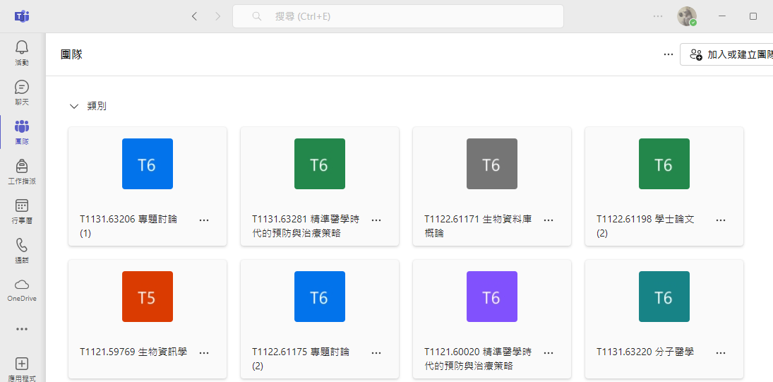
課程團隊 Course Teams

Slide 12
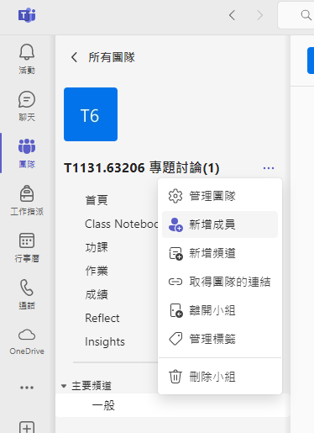
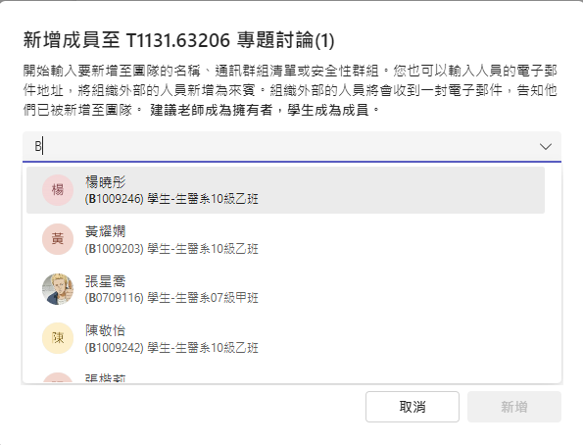
將助教新增入團隊 Adding TAs to the team

Slide 13
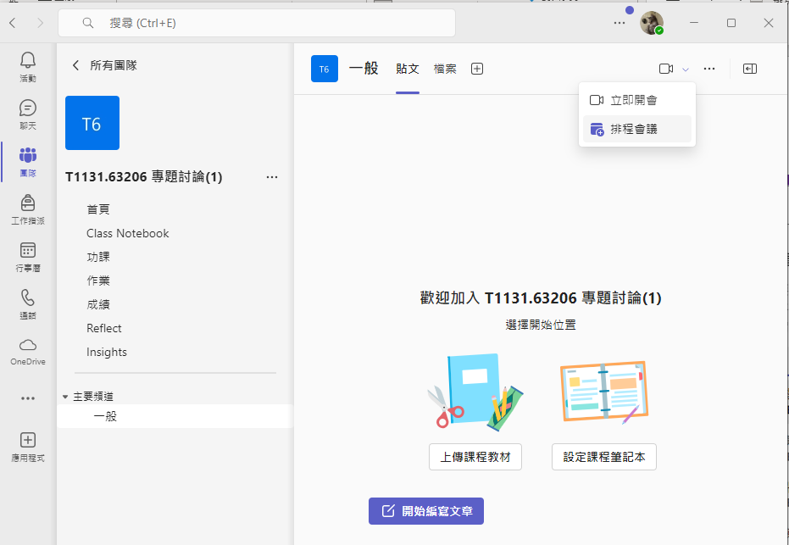
線上課程排程 Online Course Scheduling

Slide 14
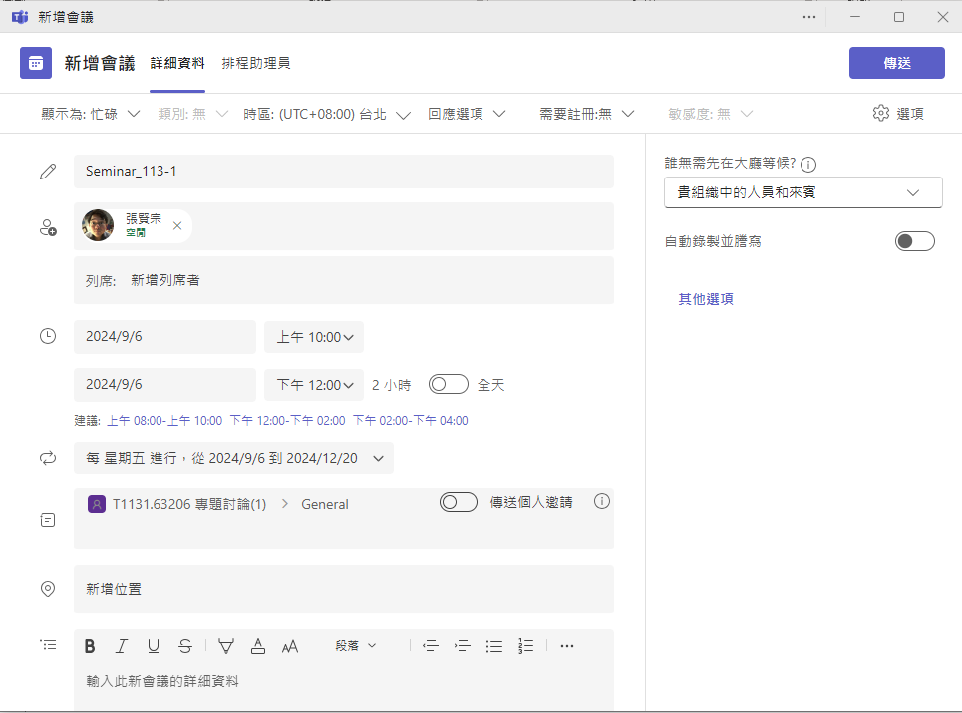
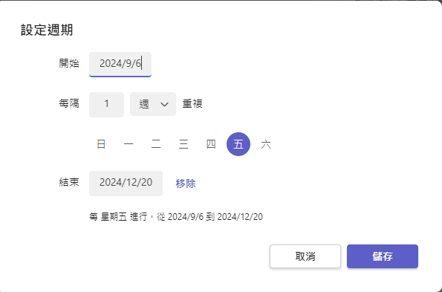

Slide 15
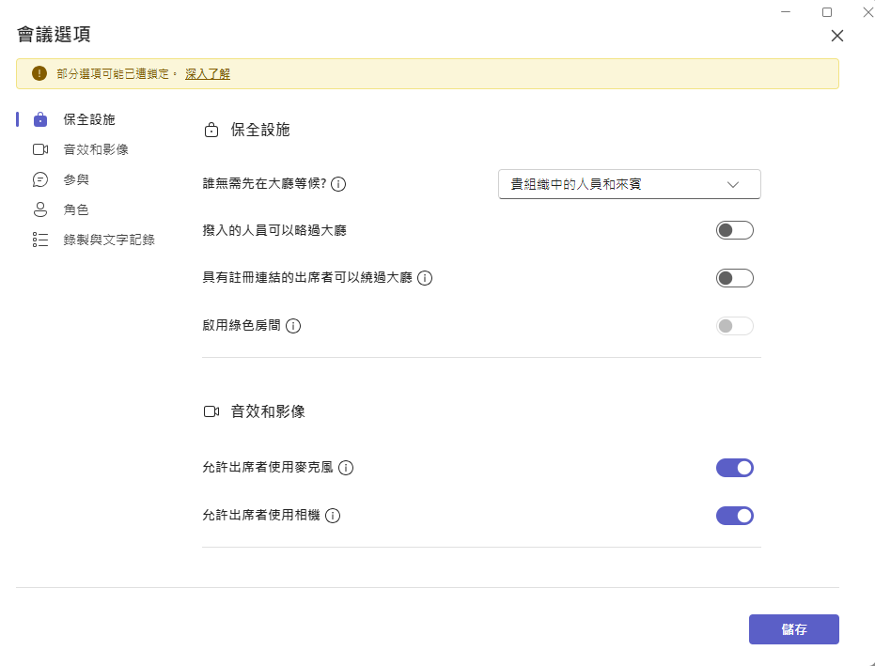
不希望被干擾可以關閉此選項

Slide 16
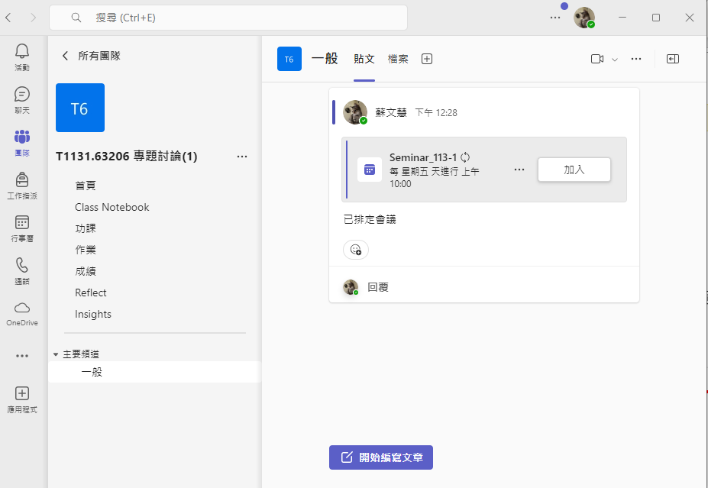
課程設定完成 Course Setup Complete
可以由此加入會議, 或由行事曆進入
You can join the meeting here, or access it from the calendar.
團隊成員可於此留言, 討論
Team members can leave a message here to discuss

Slide 17
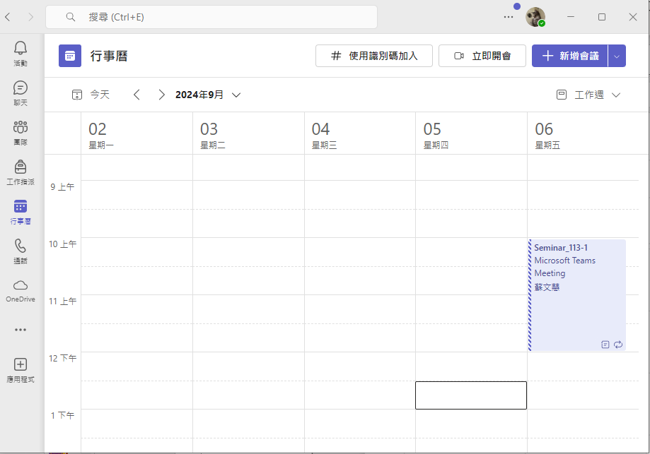
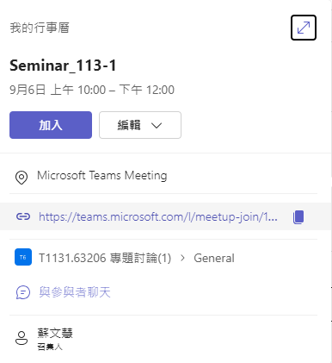
課程設定完成 Course Setup Complete
複製會議連結, 可以傳送給團隊成員
Copy the meeting link and send it to the team members.

Slide 18
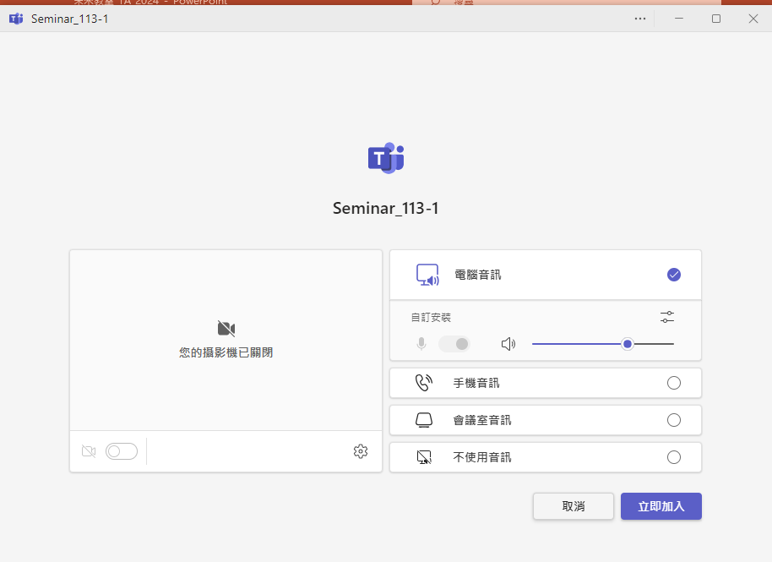
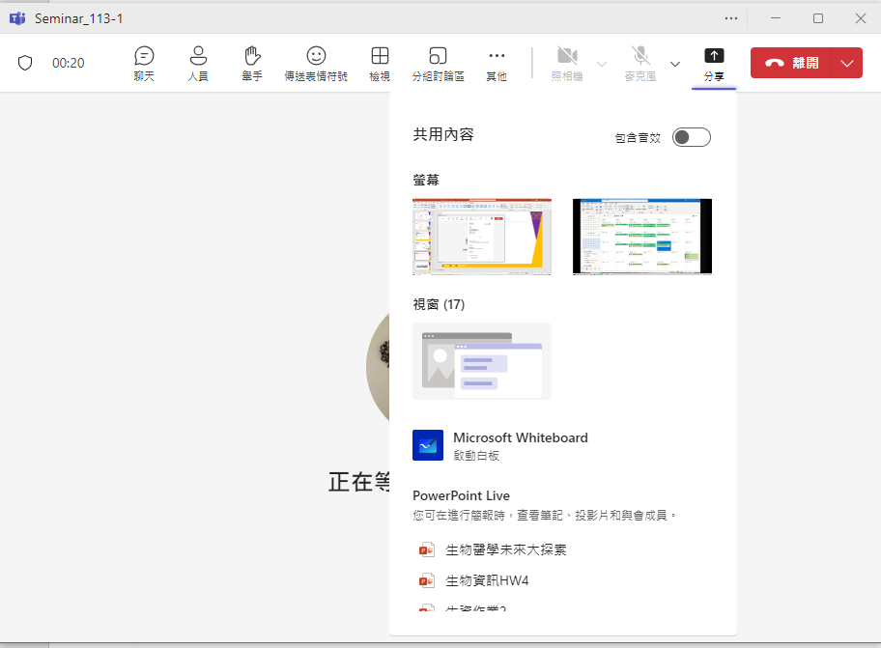
上課啦 Class in session.
分享電腦桌面
Share Computer Desktop

Slide 19
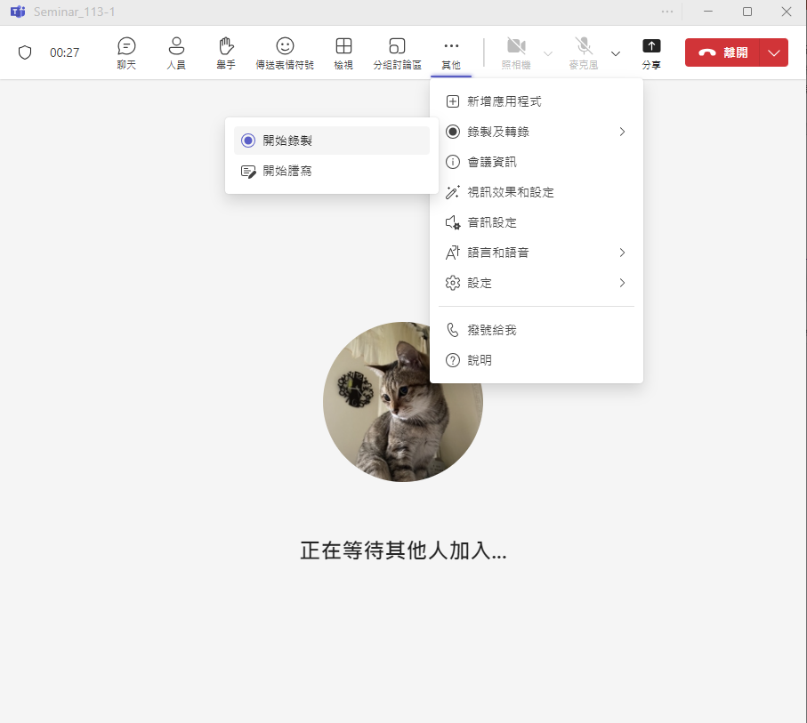
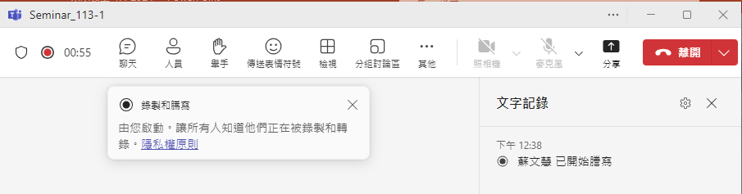
上課內容錄影 Video Recording of Classes
上課時看到這個, 表示目前正在錄製中
If you saw this. It means it's currently being recorded.

Slide 20
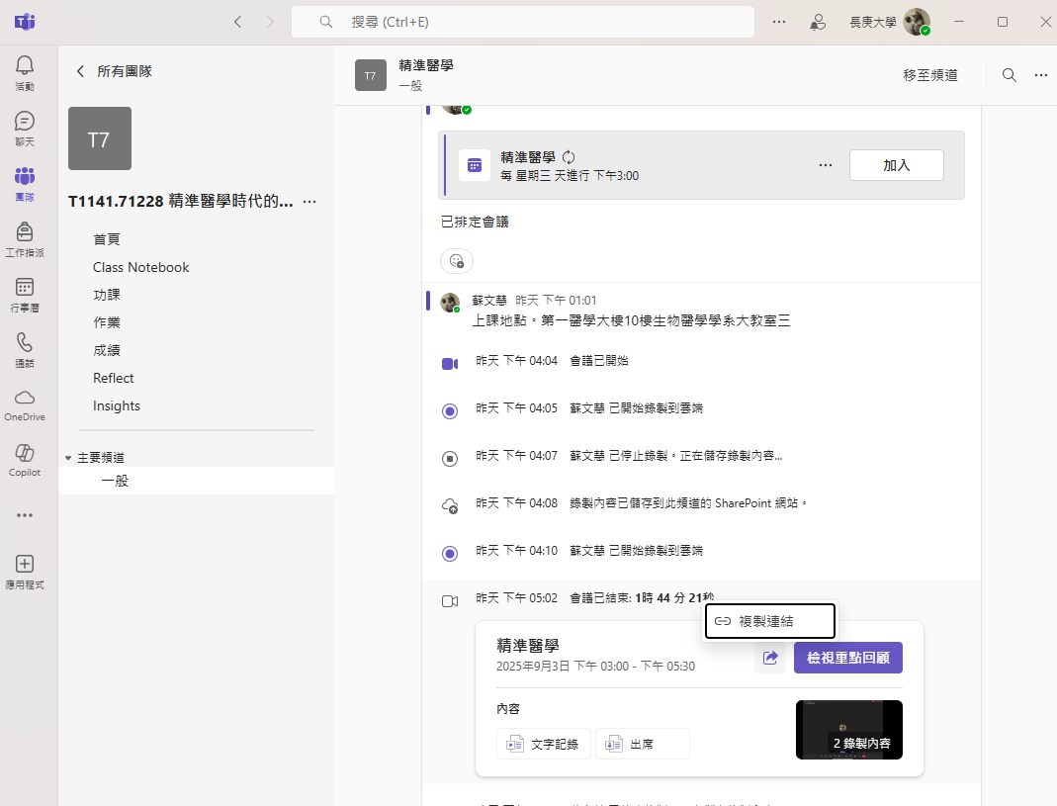
取得錄影連結 Get Video Link
開學前三週需進行課程錄製, 可把此連結複製至E-learning (但很容易失敗)
Course recording is required for the first 3 weeks of school, you can copy this link to E-learning (but it's very easy to fail)

Slide 21
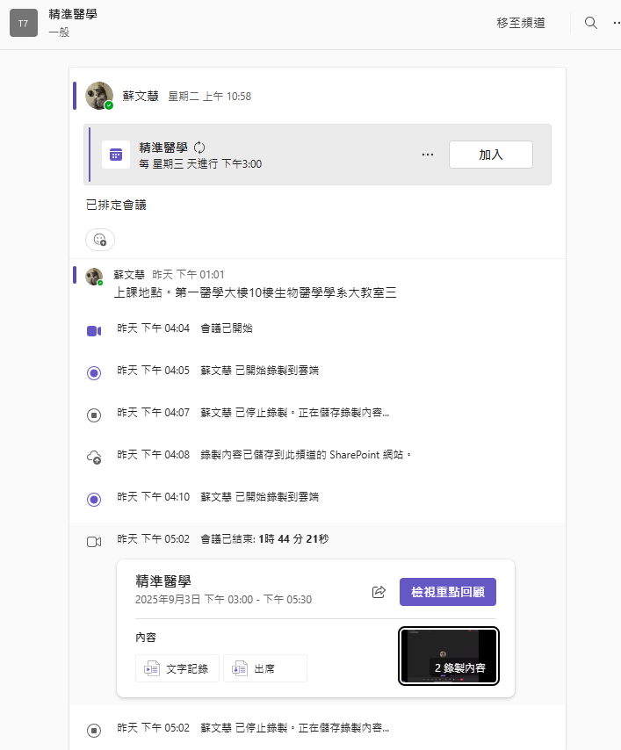
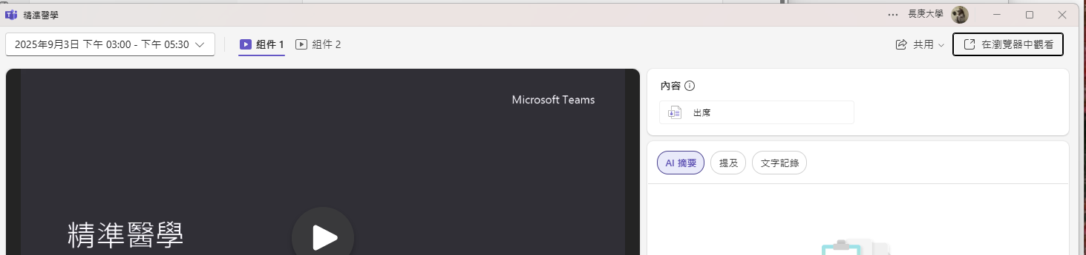
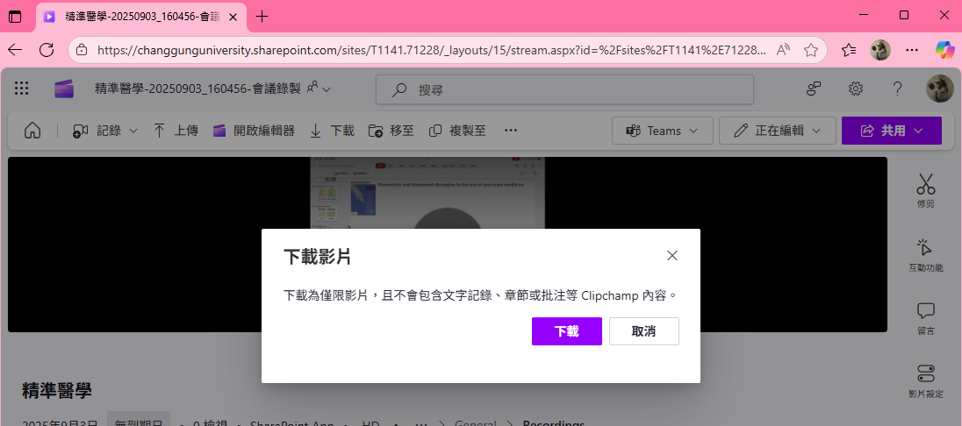
在瀏覽器中開啟可下載, 再上傳EL
Open the video in Browser and download, then upload to EL

Slide 22
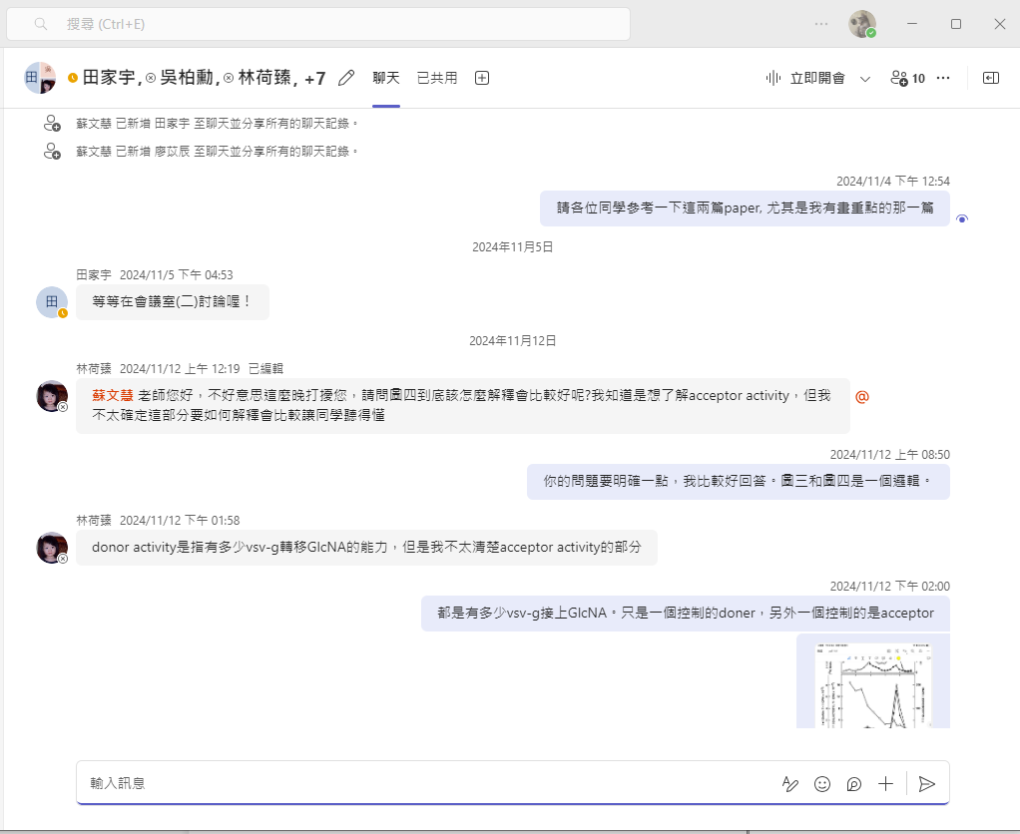
建立討論群
Establishment of discussion groups

Slide 23
Turnitin
作業抄襲比對
Assignment Plagiarism Comparison System

Slide 24
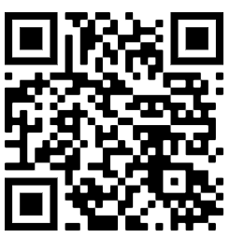
Turnitin
Turnitin是一個用於檢測學術抄襲和提高寫作質量的在線工具。它通過將提交的文件與龐大的網絡資料庫、學術文章、書籍、以及其他學生作業進行比對，來檢測可能的抄襲行為。
依據「長庚大學碩、博士學位考試實施辦法」，109學年度起舉行學位考試之學生應完成「論文原創性比對」，供學位考試委員參考。
可向長庚大學圖書館申請帳號

Slide 25
助教端Turnitin帳號設定及抄襲比對
Turnitin Account Setting and Plagiarism Comparison for Teaching Assistants
此部份需要老師的Turnitin帳號
This section requires a teacher's Turnitin account.

Slide 26
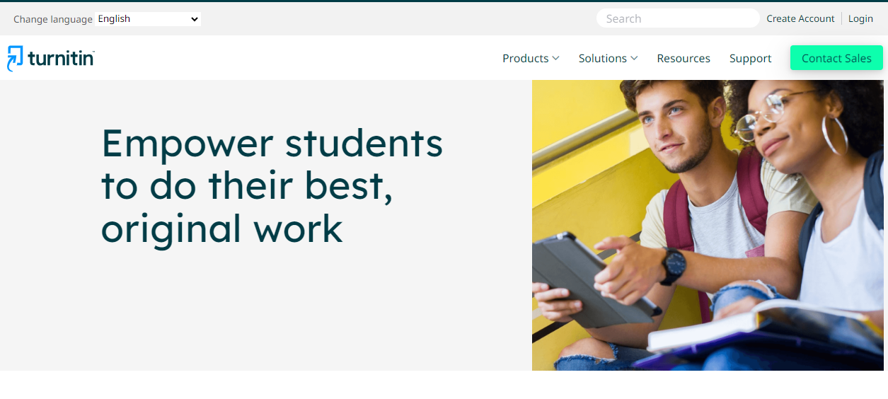
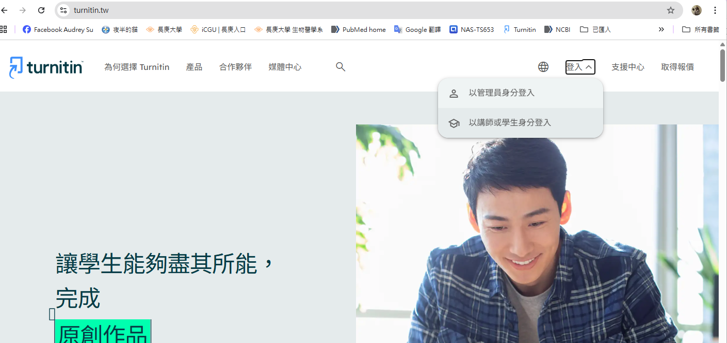
請使用英文網頁login, 中文網頁學校帳號不能使用
Please use the English webpage login
https://www.turnitin.tw/
https://www.turnitin.com/

Slide 27
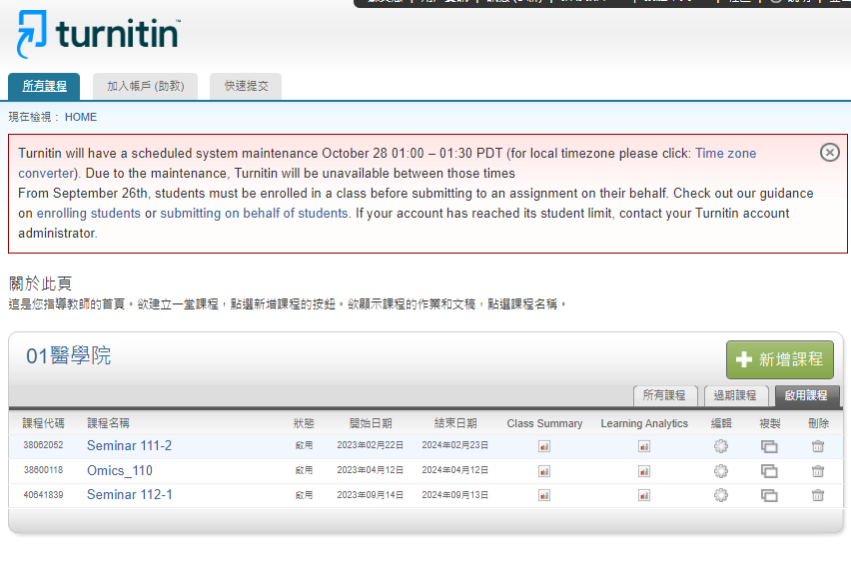
新增課程 Adding New Courses

Slide 28
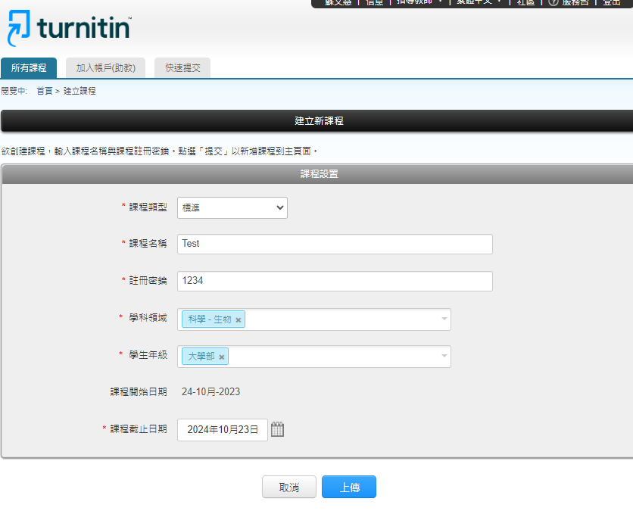
隨便設
預設是一年

Slide 29
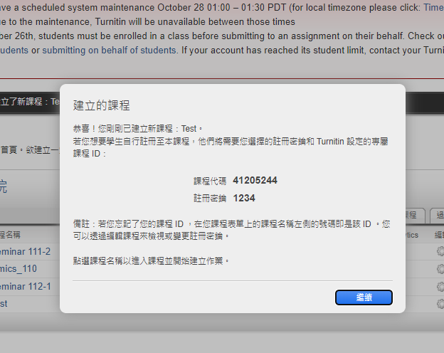

Slide 30
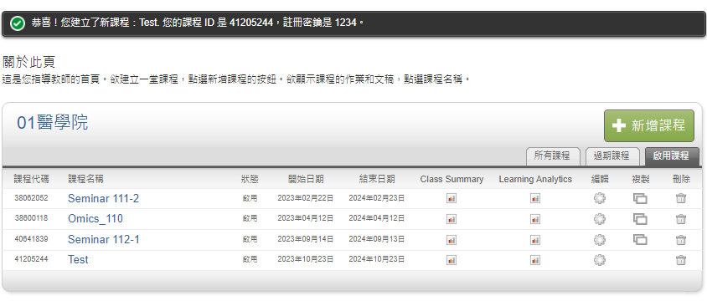

Slide 31
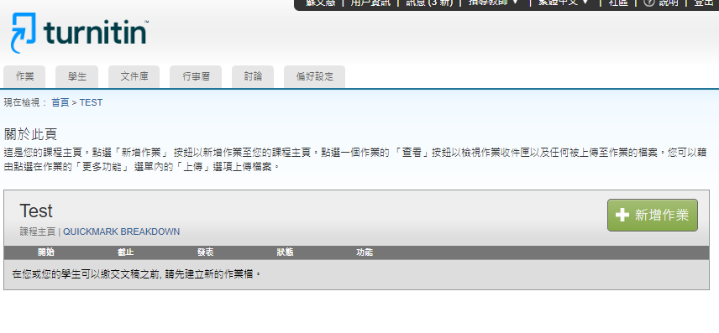
Adding Student Account

Slide 32
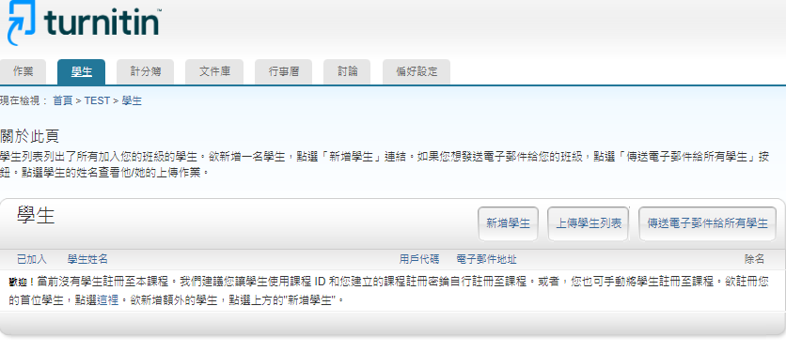
Adding Student Account

Slide 33
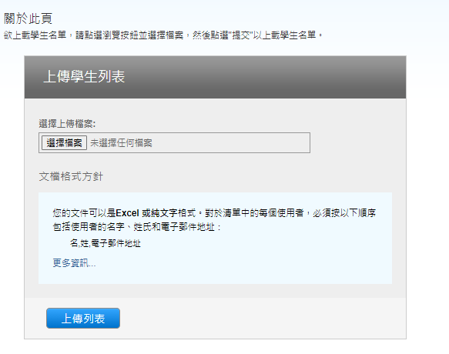
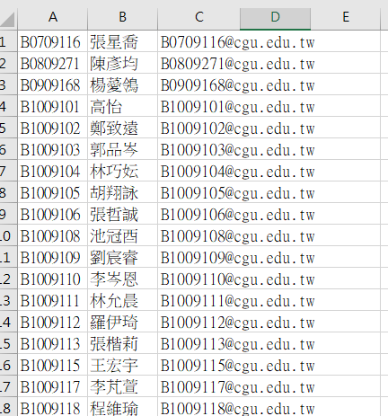
做一個這樣的Excel表, 欄位是 名, 姓, E-mail
為方便看學號, 我都設成下面那樣
Make an Excel sheet like this, the columns are first name, last name, e-mail
一按上傳會馬上寄信給學生
A E-mail will be sent to the student as soon as you clicks on the upload.

Slide 34
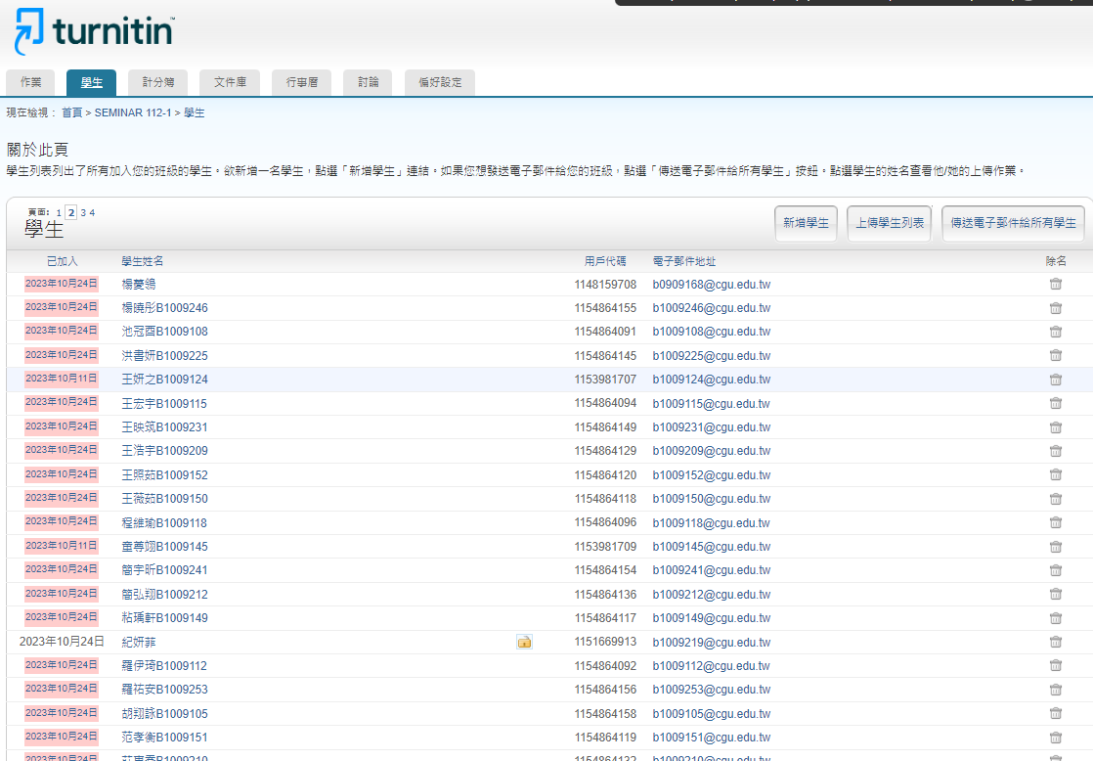
學生收到後帳號設定好會出現這個
This is what happens when a student receives a e-mail and set up the account successfully.

Slide 35
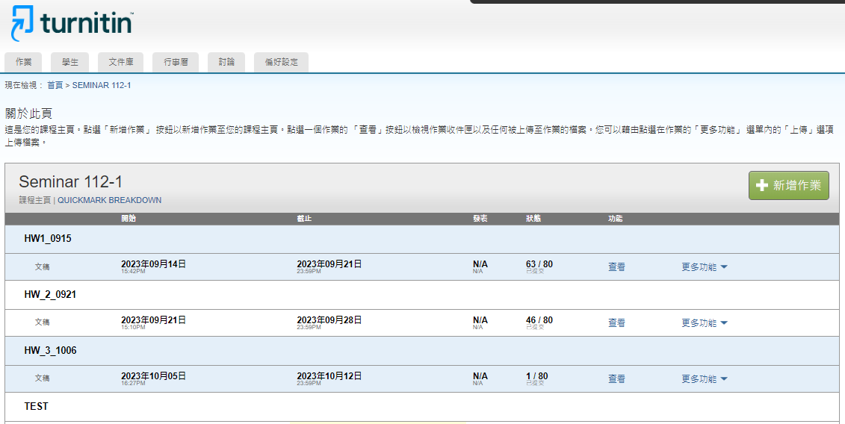
新增作業 Add a new homework

Slide 36
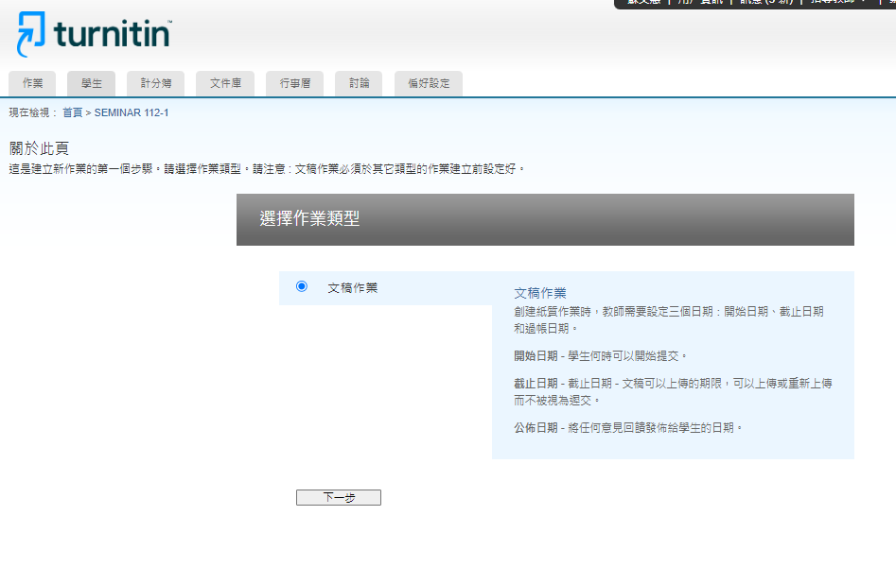

Slide 37
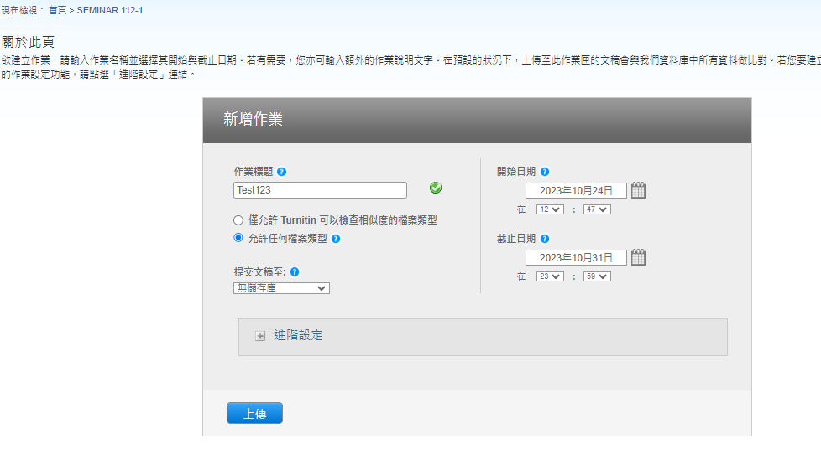
給個名字
name
預設一星期
Default due date is a week

Slide 38
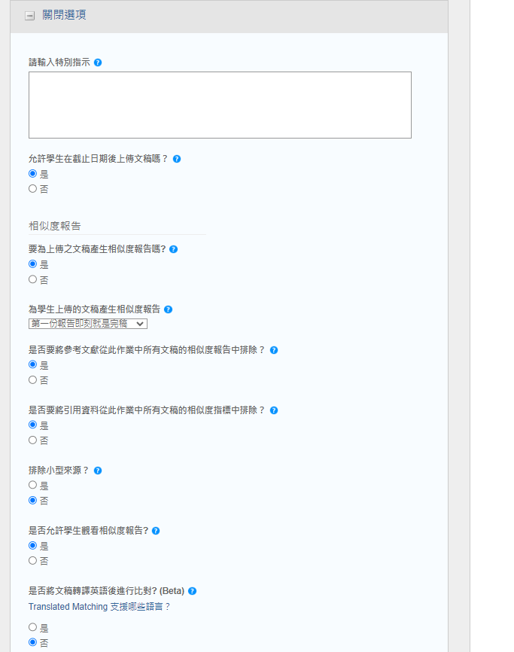
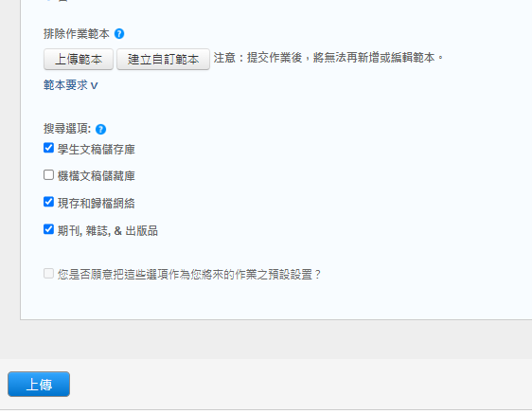
我這個設定和預設不同
我這個設定和預設不同
我這個設定和預設不同
我這個設定和預設不同

Slide 39
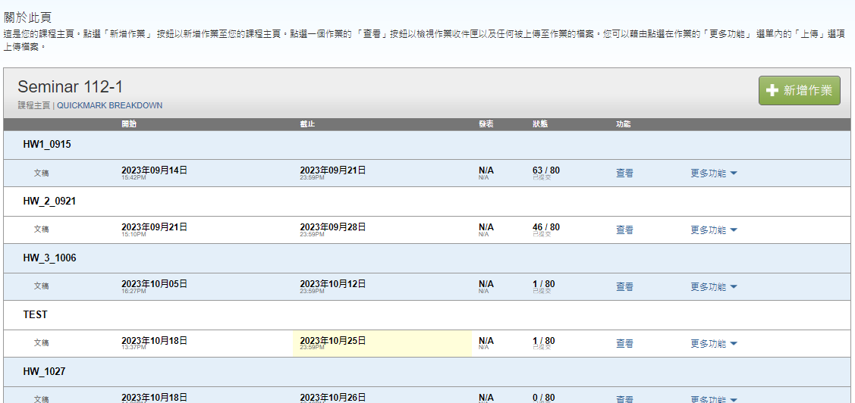

Slide 40
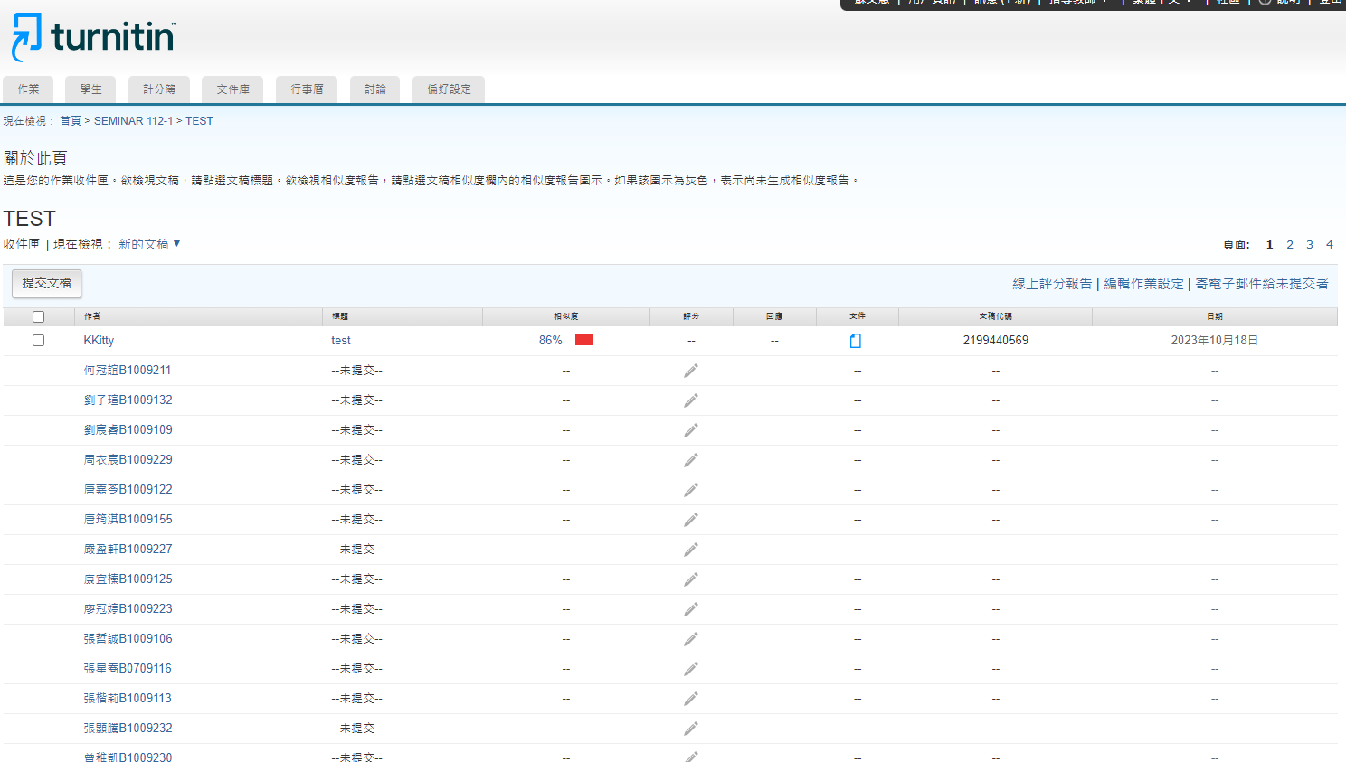
這是老師看到的頁面 This is the page the teacher saw

Slide 41
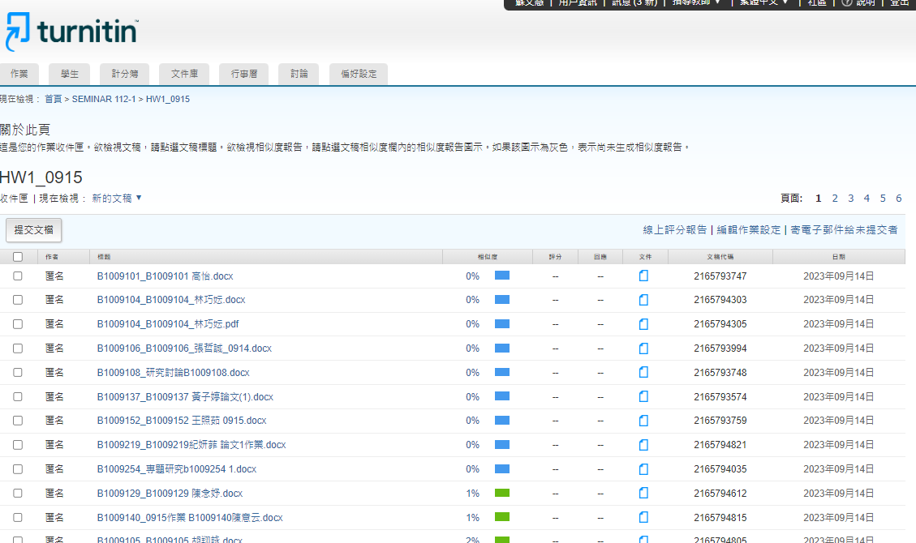

Slide 42
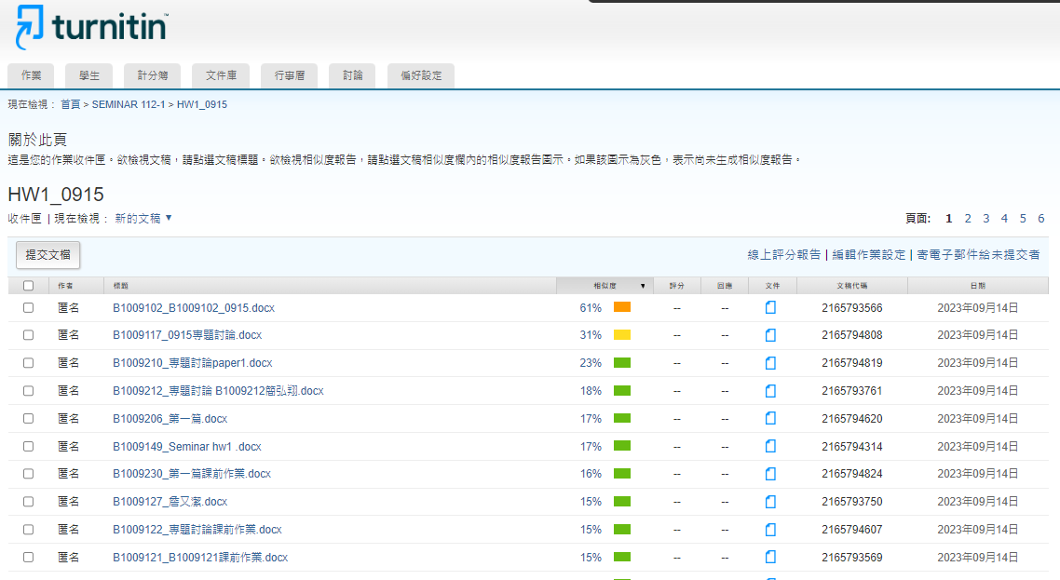
按此依相似程度排序
Sort by similarity
看報告
Read the report

Slide 43
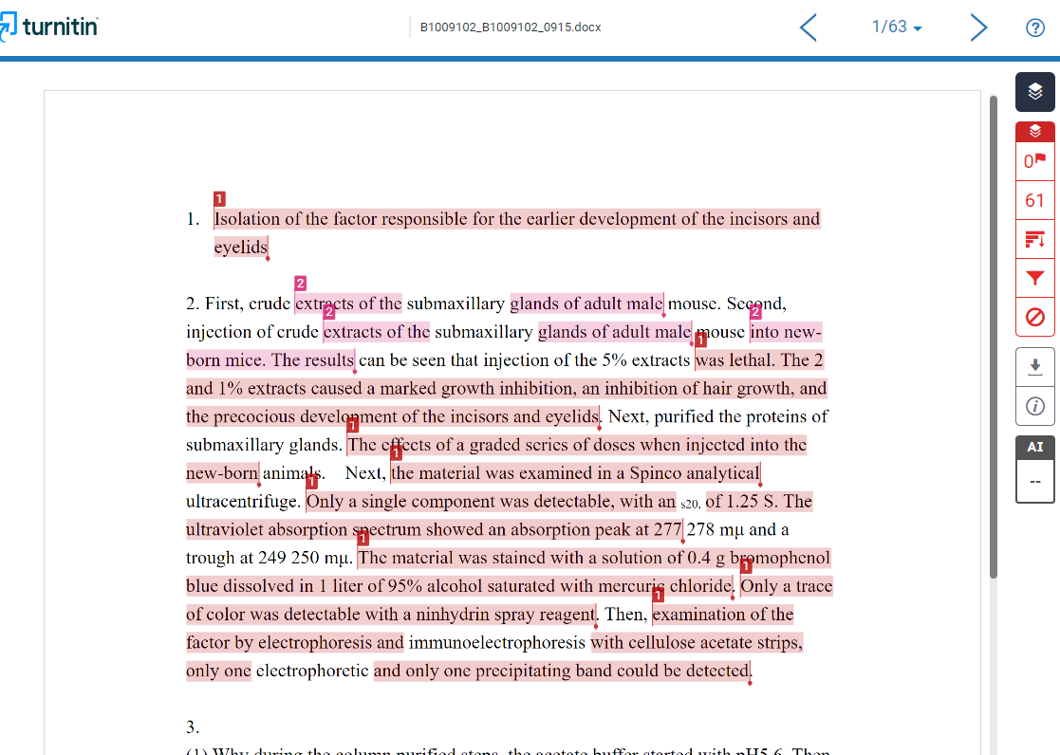

Slide 44
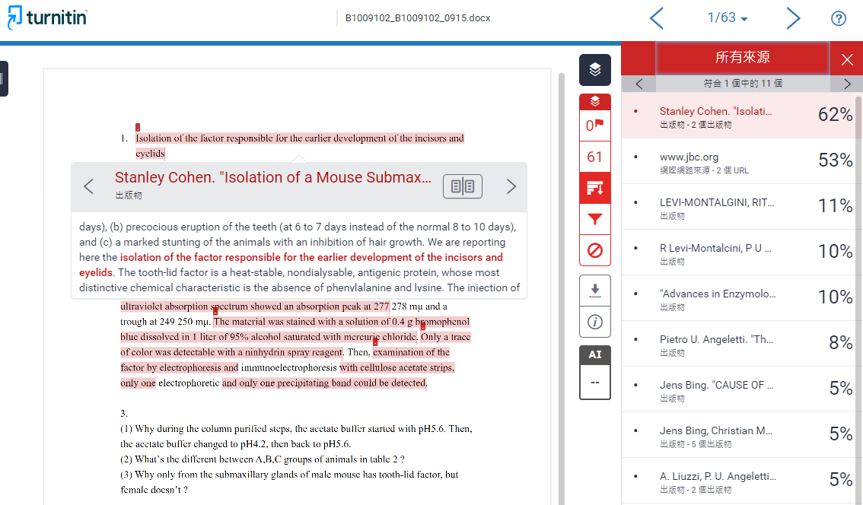

Slide 45
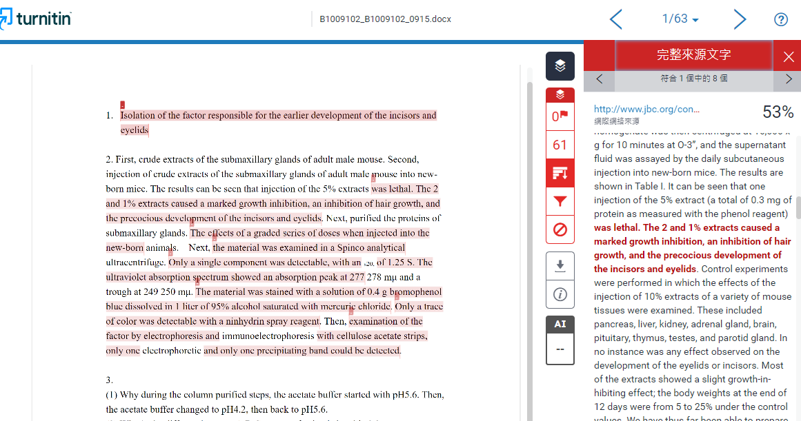

Slide 46
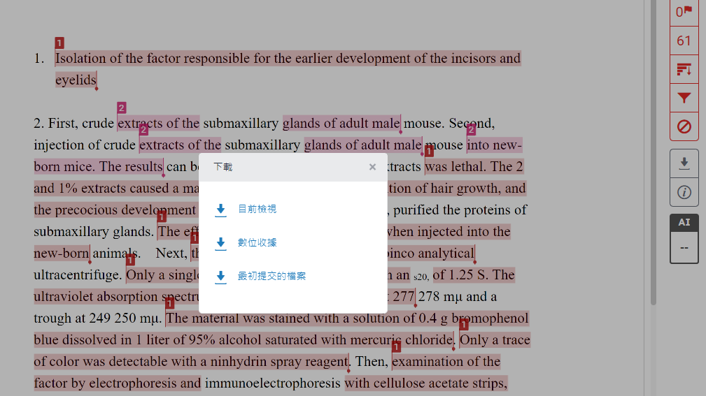
下載比對報告

Slide 47
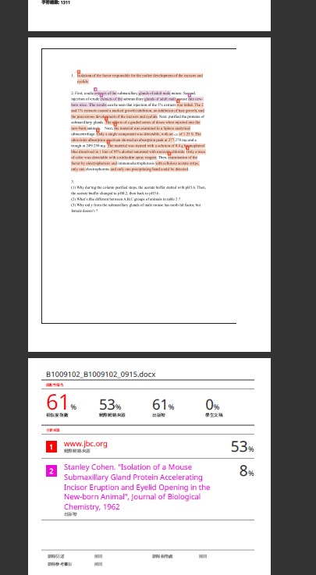
到自己電腦的[Download] 資料夾找比對報告pdf 檔

Slide 48
學生如何設定Turnitin帳號及上傳作業
How the students set up Turnitin account and uploading homework.

Slide 49
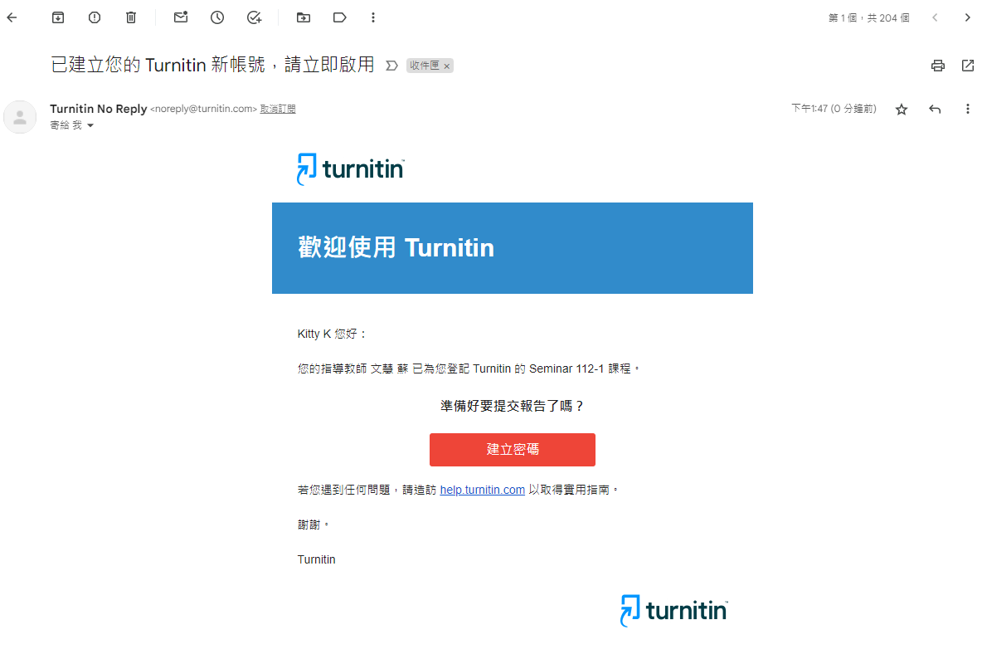
收到turnitin的信件後打開
The E-mail students received from turnitin.

Slide 50
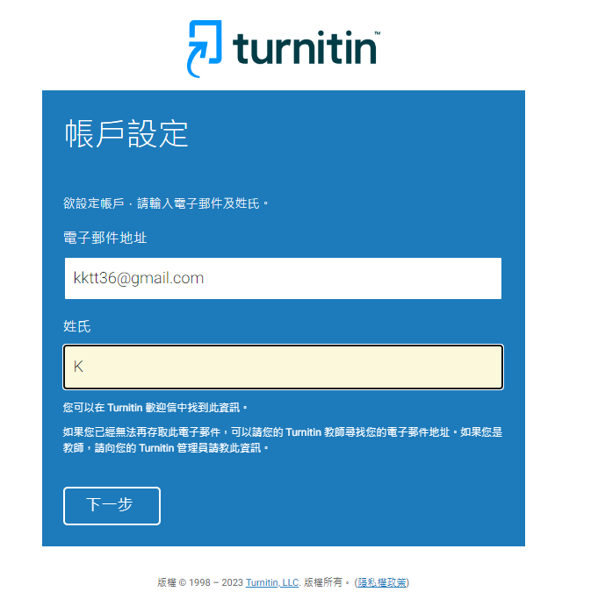
請輸入你的CGU E-mail和完整中文姓名
Please enter your CGU e-mail address and full name.
b1234567@cgu.edu.tw
王小明

Slide 51
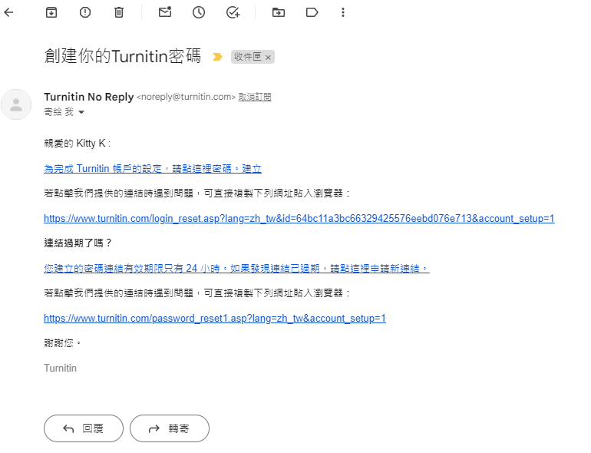
會收到另一封信, 請點選
You will receive another E-mail, please click on it.

Slide 52
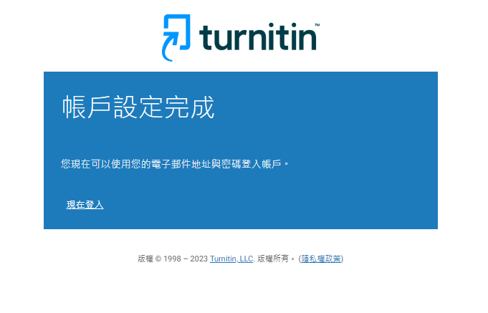
接下來是設定密碼(此頁面沒截到)
密碼必須12個字元以上, 含大小寫, 英文,及特殊符號
看到這個畫面再按現在登入
The next step is to set a password (not captured on this page).
The password must be at least 12 characters, including case, English, and special symbols.
Click Login when you see this screen

Slide 53

Key入你的帳號及剛才設好的密碼
Key in your account name and the password you just set.

Slide 54

必須設定這個提示問題及答案
This prompt question and answer must be set

Slide 55

接下來出現此頁面
This page appears next, click agree

Slide 56

請進入課程 Please click the course name

Slide 57

準備上傳本週作業 Upload assignment

Slide 58


Slide 59

務必加上文件標題
Be sure to add the title of the document
務必加上文件標題
Be sure to add the title of the document

Slide 60


Slide 61


Slide 62


Slide 63

看到上傳鍵變灰就OK了, 請記住,
每個作業在期限只能上傳一次
When you see the upload button grayed out, it's OK.
Remember, each assignment can only be uploaded once before the deadline.

Slide 64
E-Learning System
功能很多

Slide 65
E-Learning System
全校統一的數位教學平台。
  Unified digital teaching platform
校方蒐集 TA/老師 教學歷程 重要的依據。
  教師未來在各項評鑑中重要的教學足跡。
  TA 評鑑的各種佐證資料來源。
其實好用與否很大因素與習慣有關。
給老師學號，請老師把你加入 EL 的 TA。
  Please ask your teacher to add you to EL's TA.
下節課會有E-learning的詳細介紹
E-learning system will be introduced in next class…

Slide 66
E-Learning
記得幫老師在 E-Learning
  上傳教材
  發公告
  討論區跟學生互動
  上傳成績
  還可以點名
  不能點餐就是了 …

Slide 67


Slide 68


Slide 69

Enter the course office and click the list of roll call

Slide 70

Click “add new roll call” button

Slide 71

Click to start roll call

Slide 72

Let student use their phone to scan the QE Code

Slide 73
未來教室
Future Classroom

Slide 74
未來教室 設置目的
介接新科技
促進交互分享與協作的環境
靈活使用空間
Bring your own device
促進學習動機
提升教學成效

Slide 75
未來教室環境配置
講者
  2 個 大型手寫觸控螢幕
學生
  10 組 手寫觸控螢幕
  移動設備 可利用無線投影
  筆電透過 USB 設備投影 * 2
環景
  追蹤講師攝影機
  拍攝學生攝影機（固定）
  可以調配螢幕設置的課程錄影
  iPad 控制整體設施

Slide 76

未來教室使用場景
講師教學
小組分屏討論
視訊會議
錄直播課程
電子白板協作
多螢幕同步傳送
多點觸控電子白板
螢幕畫面隨時註記
板書內容立即分享
多裝置無線投影
空間彈性運用

Slide 77



教室wifi
AV_control
24250800

Slide 78
玩玩電子白板
分成兩個畫面
分男女簽名 / 分四個學院簽名 請簽 Nickname
分享出來給大家下載

Slide 79
玩玩投影功能
每個人都試試看把你的手機投影到螢幕上

Slide 80

歡迎帶老師來借用上課

Slide 81
Doodle 約時間
什麼時候期末考？什麼時候補課？
學弟妹，你們到底什麼時候有空….
  #$%)!@#~@!$~@#@#

Slide 82

Doodle 約時間

Slide 83
Doodle 好簡單
https://beta.doodle.com/create

Slide 84
Ｑ＆Ａ
又要來 Wheelofnames 了嗎！？科科…
https://wheelofnames.com/

Slide 85
Thank you !

